Slide 1
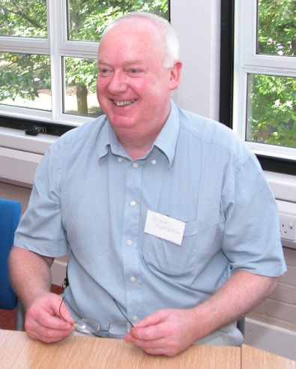
ALPS Conference 2010
Work-based Learning and Assessment for the Next Decade
Sustaining and embedding innovations
challenges and opportunities
Peter Chatterton

Slide 2
Sustaining and embedding innovations
Why
  do we need to focus more on sustainability and embedding?
What
  are the key challenges & opportunities?
How
  can this be achieved?

Slide 3
Relationship between innovation and transformation in HE
4
3
Innovation
& transformation
Transformation
but no innovation
HE-specific innovative “change & embedding” processes & techniques
Long-term “smart” partnerships
(collaboration not competition - schools, faculties, institutions, employers, sectors, international)
“Business-like” approaches
Business-driven methods e.g. continuous improvement, BPR & TQM methodologies
Incremental change
Transformation
1
2
No transformation
and no innovation
Innovation
& some transformation
Strong drivers for change
Funding oriented more towards local transformations
Transformations not always embedded institutionally
No strong external drivers for change
Organisational inertia
Innovation

Slide 4
Transformation is cyclic, not linear
Benchmarking
Transformation
(collaborative)
Reflecting
Planning
Enhancement &
innovation
programmes

Slide 5
Why?
Too much re-inventing of the wheel in short-term funded projects
Changing funding environment
Funding agencies are increasingly focusing on collaboration, transformation, efficiencies, capacity-building and impact & benefits realisation for the sector
Employers will only fully engage with HE long-term if their complex and specific needs are met & sector partnerships are formed
Institutions need to become more responsive, agile and efficient in order to meet employer needs

Slide 6
Challenges
A funding culture mindset
Perceptions of education being a cost rather than an investment
Impact & costs/benefits not normally fully understood or measured
Academic reward mechanisms favour “local” innovations - not embedding in schools, faculties, institutions
How to change mind-sets towards the benefits of co-operation – at all levels
How to change academic mind-sets towards WBL pedagogy and employer engagement

Slide 7
Key opportunities
Need to focus on transformation as well as innovation:
Innovations in HE-specific change & embedding processes
Shared approaches towards a better understanding of impact, costs & benefits & development of models
Developing sustainable sector “smart” partnerships

Slide 8
Innovations in HE-specific change & embedding processes
Examples:
CABLE Process – University of Hertfordshire
  a local model of change within Schools
CABLE – Transfer
  Transferring the CABLE Process to the HE Sector
Change Management Simulation
  (JISC/Insead simulation toolkit)
Scenario Planning
  (JISC toolkit)
Collaborative benchmarking in WBL/e-learning
  (benchmarking toolkits)

Slide 9
CABLE
CABLE – Change Academy for Blended Learning Enhancement
a local model of change within Schools
Develop effective teams across disciplines
A focus on the strategic interests and needs of the participating Schools
Academic-led
Student involvement
Achieve transformative and sustainable change in blended learning
Develop partnerships between Schools and the Blended Learning Unit
Develop future change agents
Develop toolkit for future sustainable change projects
Develop curriculum design toolkit
http://www.herts.ac.uk/about-us/learning-and-teaching/cable.cfm

Slide 10
CABLE Process
CABLE 1
CABLE 2
CABLE 3
CABLE 4
Decreasing funding
Expression of Interest
Team Leaders
meeting
Personal development
Planning
Peer support
ITM-1
(+CF)
ITM-2
(+ CF)
ITM-3
(+ CF)
ITM-4
(+ CF)
ITM-5
(+ CF)
ITM-6
(+ CF)
Exploring the issue and generating ideas
Reframing the issue and achieving focus
Action planning
Testing that the plan is robust
2 day residential event
Support (BLU)
Peer support
Implementation
Presentations
Peer critique/reflection
Future change agents/plans
Final AwayDay

Slide 11
CABLE Techniques (1)
Collage – creating a Vision
Reversals – create an opposite to what you want to achieve
Minimise/Maximise – exaggerate or minimise
Super-heroes – how would batman tackle an issue
Systems Thinking – focusing on an ultimate goal
Stakeholder Analysis – understanding stakeholder needs/expectations
Engagement/communications strategy & plan
Knowledge Fair – exchanging knowledge
Brain-writing followed by Snowballing – ideas and consensus building
Anonymous Voting – voting on ideas
Alternative Scenarios – how ideas can be implemented
5 Ws and H – What, Why, When, Where, Who, How

Slide 12
CABLE Techniques (2)
Implementation:
  Checklists
    Resources required, motivation & commitment, resistance, procedures, structures & policies to be overcome (or exploited), risk, power struggles, clashes, climate
  Force Field Analysis
    Mapping restraining forces and drivers for change
  Bullet proofing
    What can go wrong, how likely, how to mitigate

Slide 13
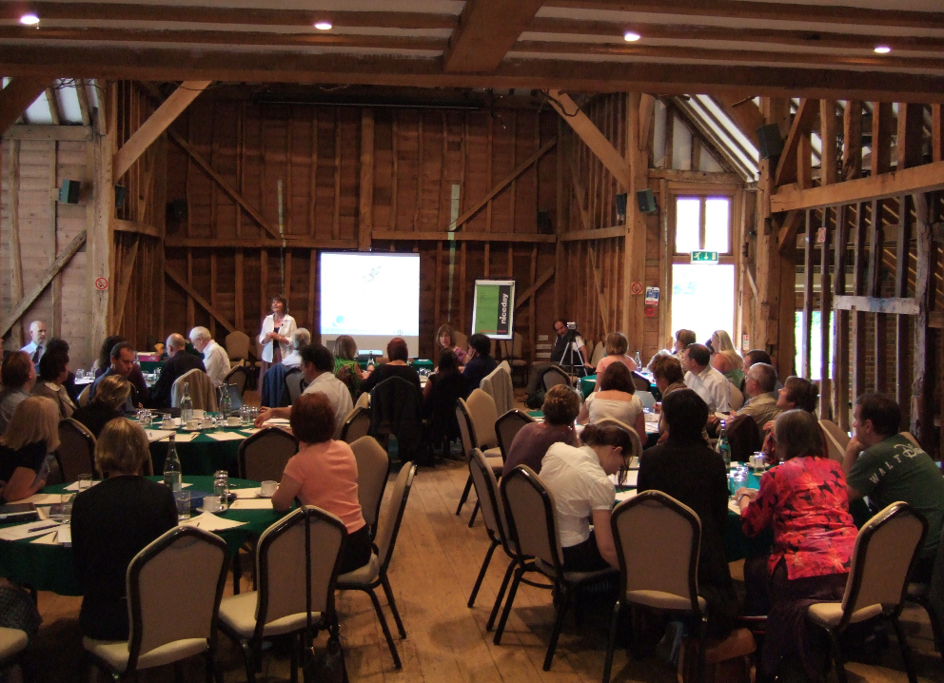

Slide 14
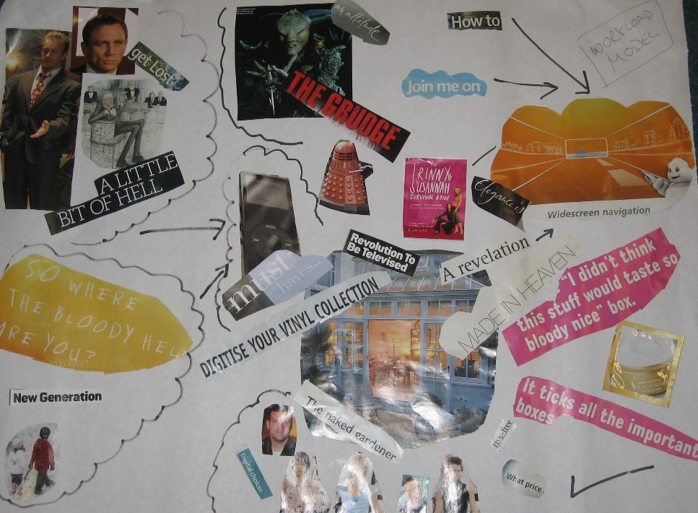

Slide 15
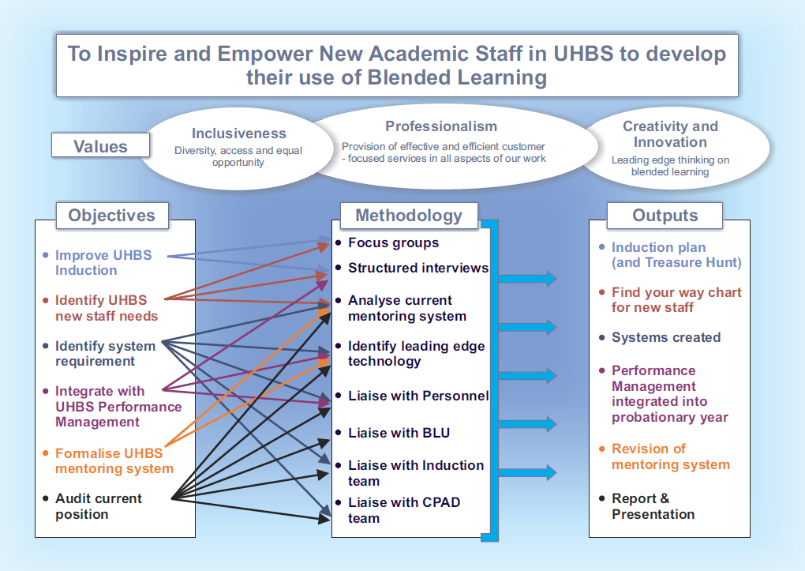

Slide 17
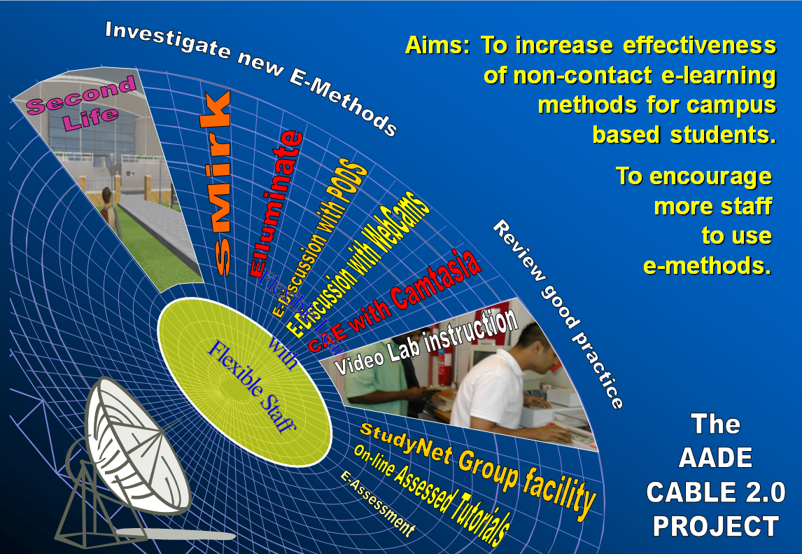

Slide 18
CABLE Transfer
Sector level change
Equipping other HEIs to implement the CABLE process
Oxford Brookes
University of Sunderland
University of Reading
St Mary’s University College
University of Worcester
www.cable-transfer.net

Slide 19
Change Management Simulation
A simulation to support teams in implementing organisational change in HEIs, helping them to:
understand the need to work within existing culture(s)
be able to describe the stages of a transition
understand the need for different approaches at the various stages
understand how individuals react in different ways to change
appreciate the roles of formal and informal networks for communicating the need for a resilient approach to implementing change
JISC infoNet: http://www.jiscinfonet.ac.uk/infokits/change-management/index_html

Slide 20
Simulation overview
Humfeld University
Graduate School of Management
Organisation Chart
Challenge:
Persuade Prof deJong and colleagues to adopt a new technology system
Gather information
Use resources
Implement different initiatives
Monitor progress
Aim
Act as a change agent to get as many adopters as possible

Slide 21
Scenario Planning
Strategic group planning tool that assumes the future can differ greatly from today
Evolved from uses in corporations e.g. Shell
A method for anticipating the future by understanding the nature and impact of various driving forces & creating a series of “different futures”
A group process which encourages knowledge exchange and widening the participant’s perception of possible future events
Development of shared understanding of complex issues
Encourages “think the unthinkable” scenarios
Scoping
Trend Analysis
Building scenarios
Generate options
Test options
Action plan
JISC infoNet - http://www.jiscinfonet.ac.uk/tools/scenario-planning/index_html

Slide 22
Collaborative benchmarking for WBL/e-learning
E-Learning collaborative benchmarking & toolkits established in HE (but not sustained)
Development of WBL benchmarking toolkit?
Need for HEIs to (collaboratively) drive this with some agency support

Slide 23
Shared approaches towards a better understanding of impact, costs and benefits
Both employers and providers need to better understand impact, costs and benefits
Programme teams need to better understand costs and benefits of WBL pedagogies and e-learning
Many existing approaches to assessing costs and benefits have been too complex
New models of measuring, impact costs and benefits need to be developed
Becta have developed “business cases” for e-learning in FE/ACL
Impact should ideally align with regional and national economic and education targets (sector approach)

Slide 24
Developing sustainable sector “smart” partnerships
Learn from the leading sectors e.g. health, engineering
HEIs can learn from effective practice in FE
Partnerships should ideally align with national/regional objectives & regulatory requirements
HEIs and employers should aim to bring sector/national bodies into the partnerships e.g. SSCs, professional standards bodies, sector agencies, employer consortia
Ensure win-win based “smart” partnerships which align with each partner’s strategic objectives and business plans
Help to develop “intellectual capital” of employers (Middlesex)
Develop better collaboration between HEIs (e.g. SIGs)

Slide 25
Key opportunities - summary
Need to focus on transformation as well as innovation:
Innovations in HE-specific change management processes
Shared approaches towards a better understanding of impact, costs & benefits & development of models
Developing sustainable sector “smart” partnerships

Slide 26
New overseas opportunities???
Export of UK expertise in technology-enhanced learning:
Ed Balls has set-up a Taskforce (Lord Puttnam) to develop the overseas market (Jan 2010)
Attendance of 63 overseas Ministers of Education at the recent 2010 Learning and Technology World Forum (LATWF) – to discuss the theme “re-imagining education”
... opportunities for partnerships, learning, R&D, collaborative projects/provision, consultancy etc???

