Slide 1
TRANSFORMING THE STUDENT EXPERIENCE:
Learning through simulation?

Slide 2
Agenda
Background to clinical education for Allied Health Professionals (AHPs)
History of simulation
Simulation as an adjunct?
Example
Future

Slide 3
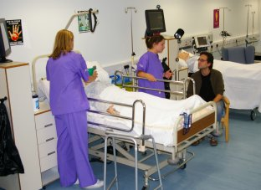

Slide 4
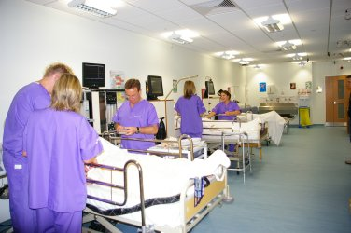

Slide 5
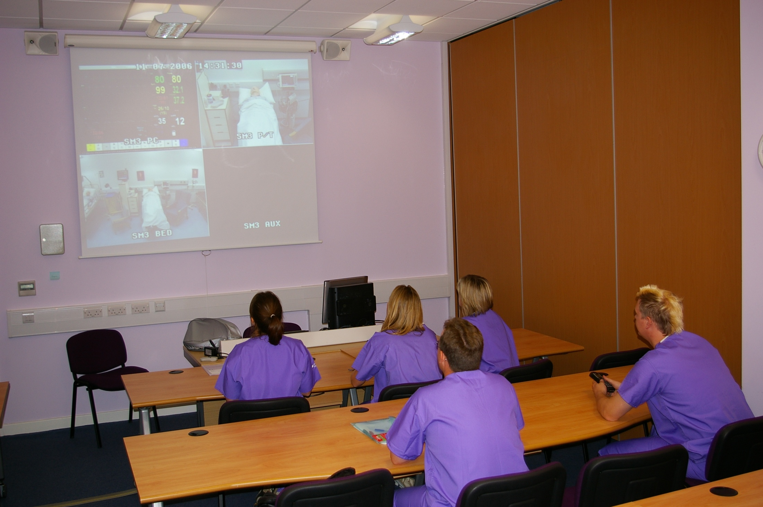

Slide 6
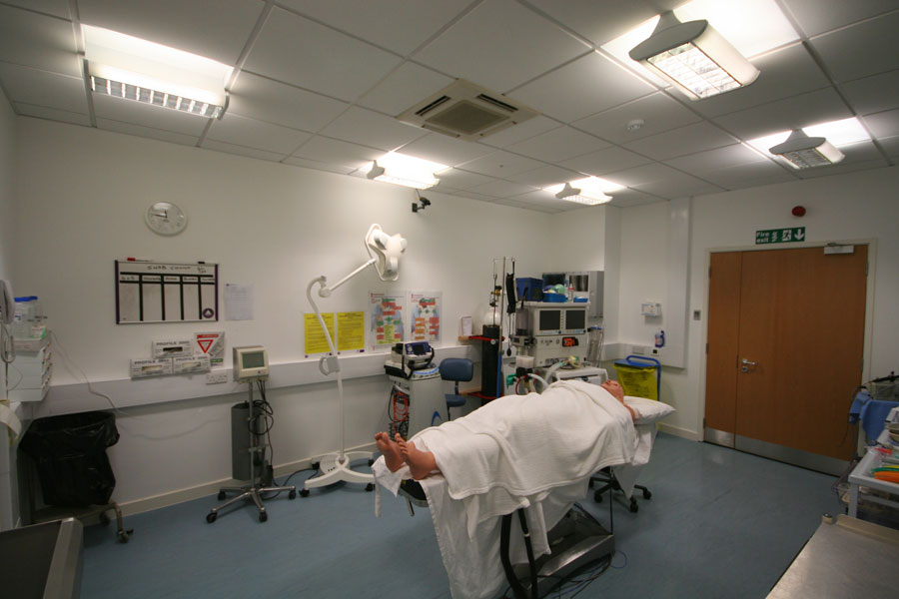

Slide 7
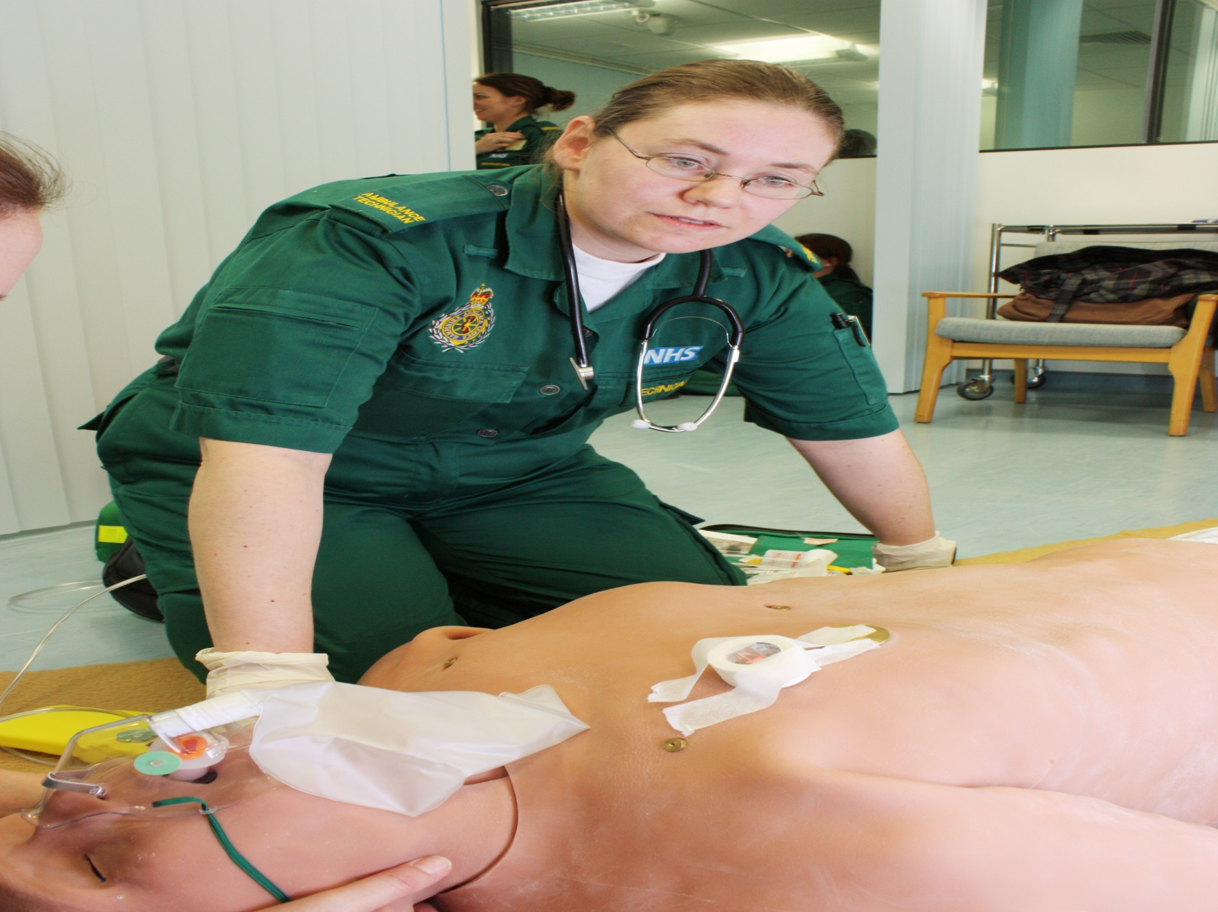

Slide 8
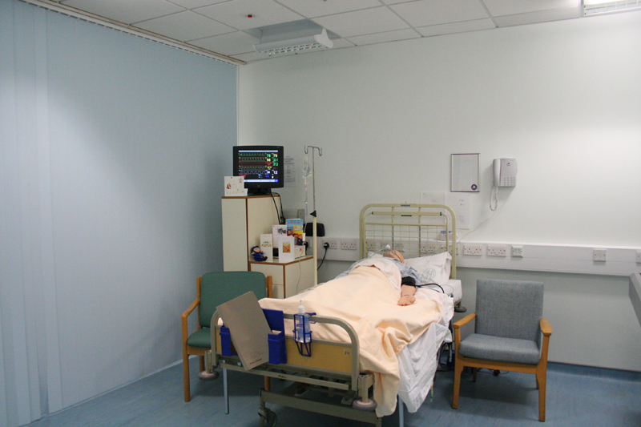
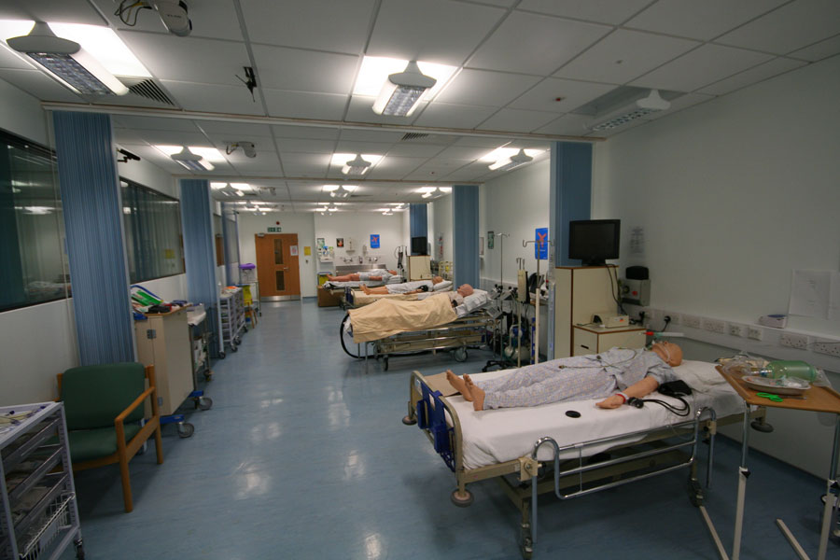

Slide 9
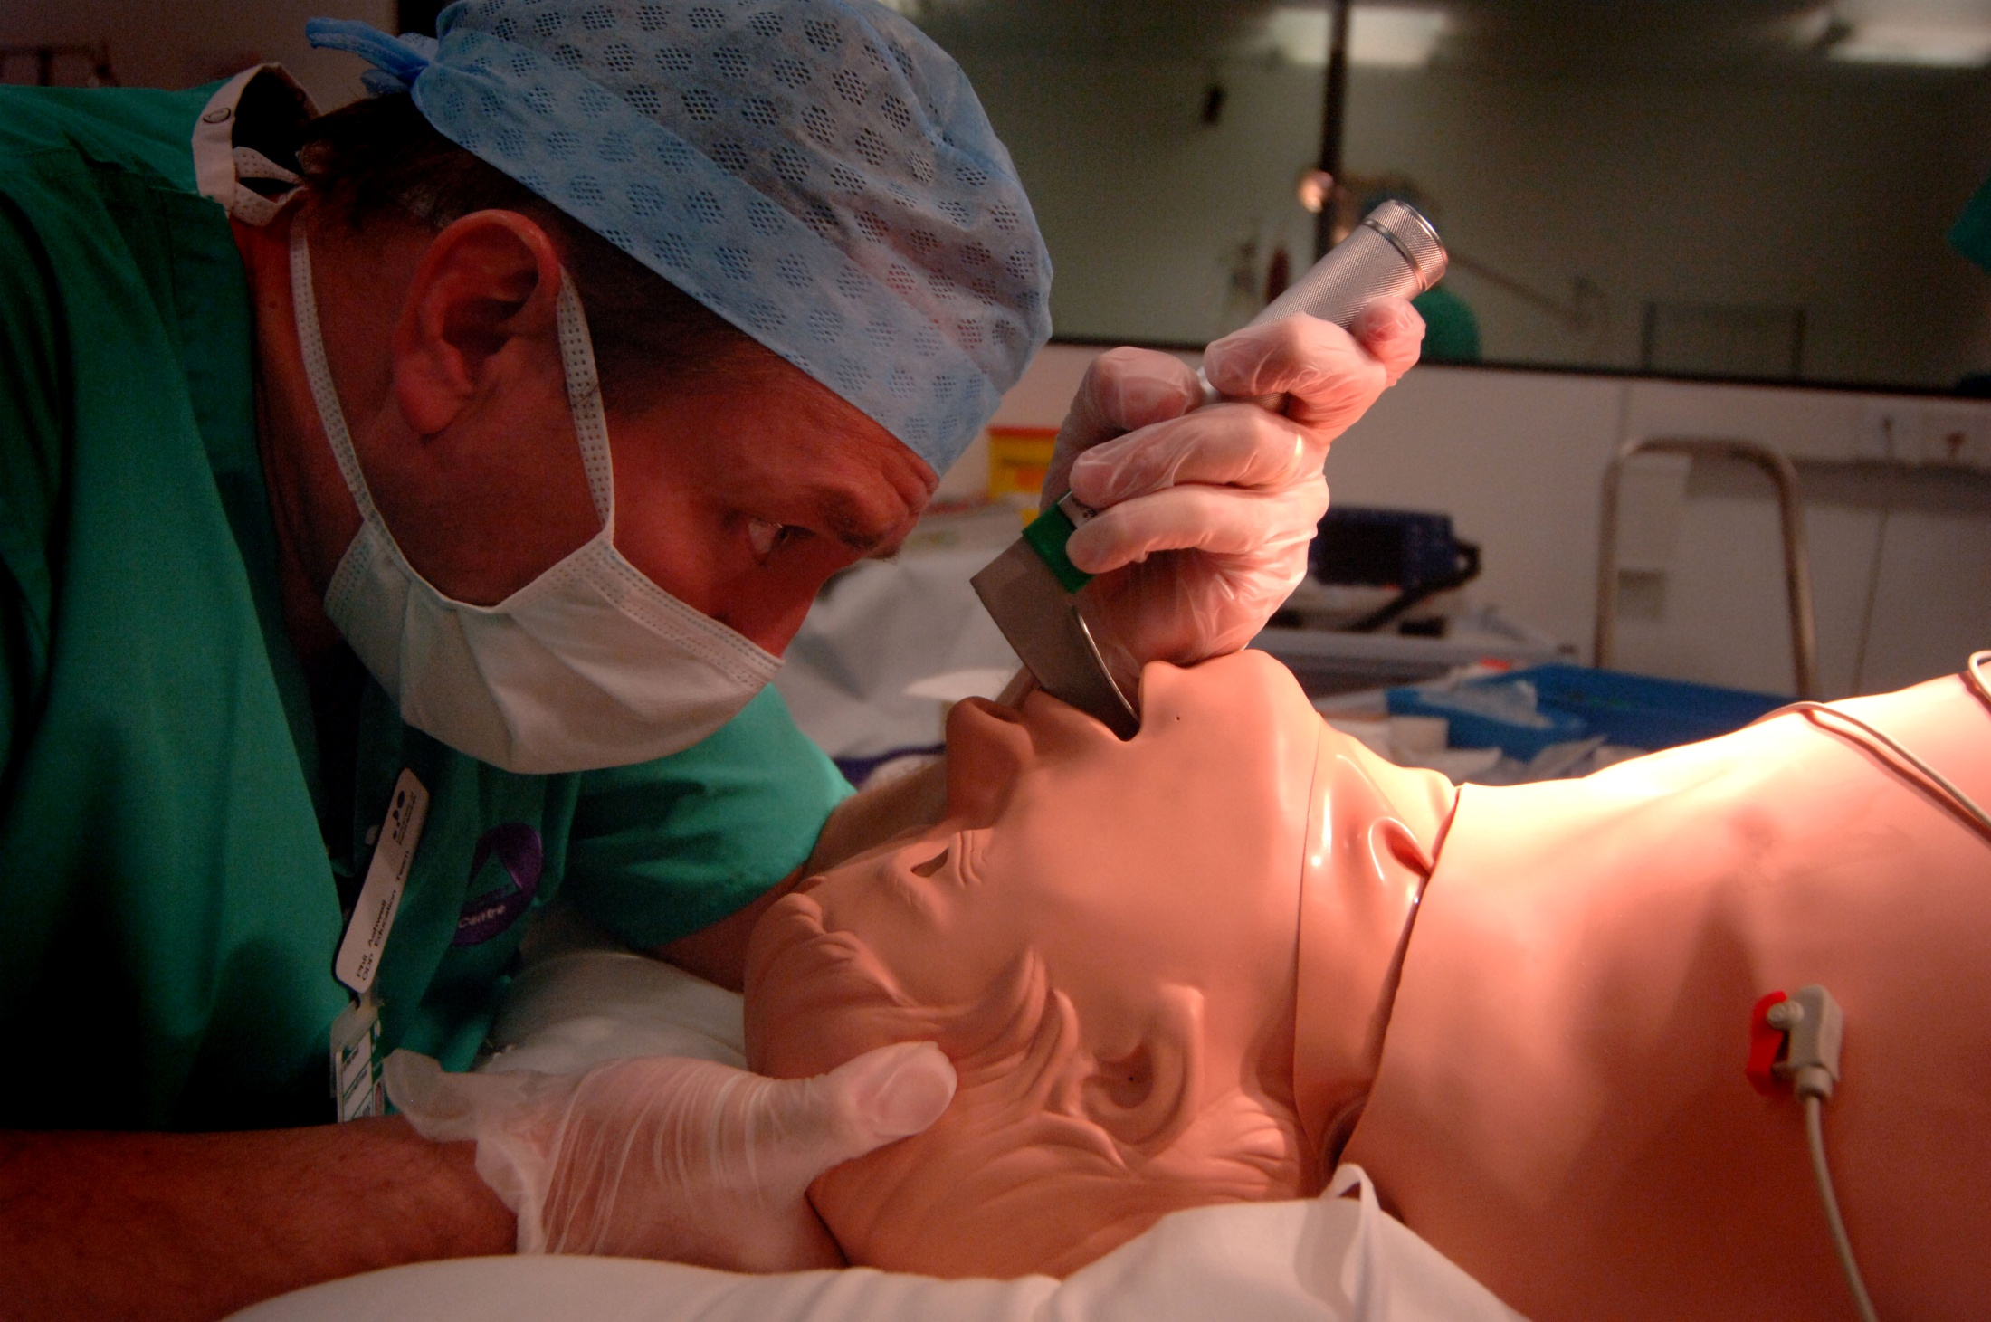

Slide 10
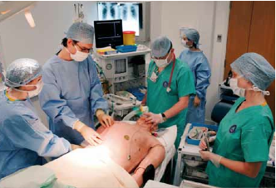

Slide 11
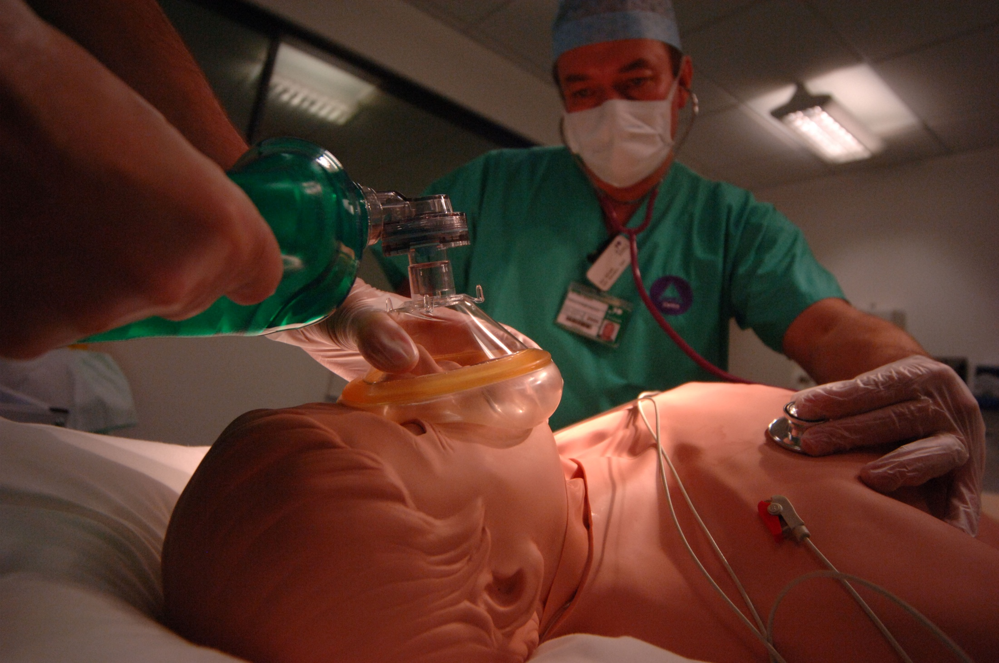

Slide 12
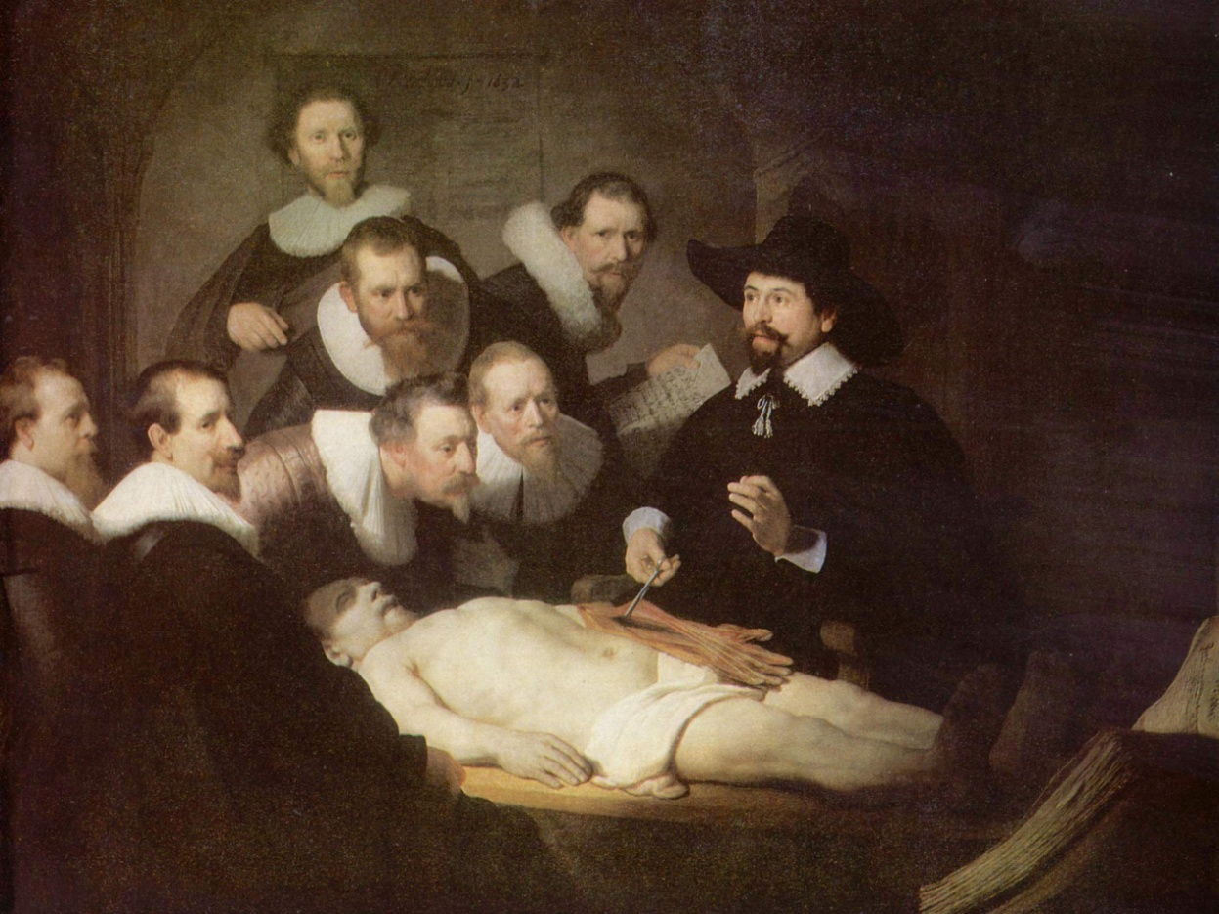
History and context of medical education
The Anatomy Lesson of Dr. Nicolaes Tulp
Rembrant, 1632
The Anatomy Act did clearly establish to whom a dead body belongs. Until relatively recently, the principle that the 'only lawful possessor of the dead body is the earth' prevailed in the UK.

Slide 13
Background to clinical education for Allied Health Professionals (AHPs)
Apprenticeship
Socialisation

Slide 14
Apprenticeship
Historical model of education
Alder Hey / Bristol enquiry highlighted problems
Teaching belies absolute patient care
Disparity between what the mentor “wants” to teach and what the student “needs” to learn

Slide 15
Socialisation of students: Situated learning (One theoretical perspective)
Shared repertoire / joint enterprise (policy)
Community of practice
Mutual engagement (care of patient)
The stronger students are usually accepted into the community either through excellent knowledge and skill demonstration or pure belligerence

Slide 16
Learning in placements?
Social learning- sometimes poor teaching
Unstructured learning unsupervised performance –learning by osmosis
Self-directed practise – reinforcing
poor techniques if unsupervised
Notes:
Learning needs to be structured. Discovery learning is OK in some situations but not in nursing where patient care is affected and you have to achieve competence in a given period of time.

Slide 17
What is simulation?
Simulation is defined as a:
“real world event that that represents a referent which then draws its essential meaning from that referent”
Unlike a simulator:
“a simulator is comparable to a genetic code, and a simulation to the realization of that code into the living organism”
Crookhall, Oxford and Saunders (1987)

Slide 18
History of simulation
Jousting, chess, war-gaming, military exercise, Aviation
1832 – Anatomy Act
1960’s – SimONE
1980’s –GAS
1990’s – Surgical haptic simulators
2000’s – HPS/ECS
2010 – 3G/iStan

Slide 19
Defining simulation types
Wargaming
Aviation
Nuclear industry
Space programme
Tribal dancing
Military training
Jousting
Chess
Emergency services
Forensics

Slide 20
Simulation as a concept
There are many terms that are afforded the term simulation, including:
Low fidelity manikin
Hi Fidelity manikin
Part task trainers
Games (driving rehearsal)
Haptic systems
VR
Simulated patients
Multimedia

Slide 21
Hi fidelity simulation advantages
Draws referent from clinical practice (context)
Aims to facilitate suspension of disbelief
Allows for 4D teaching (time)
Allows for repetition and rehearsal
Stress innoculation (covert sensitisation)

Slide 22
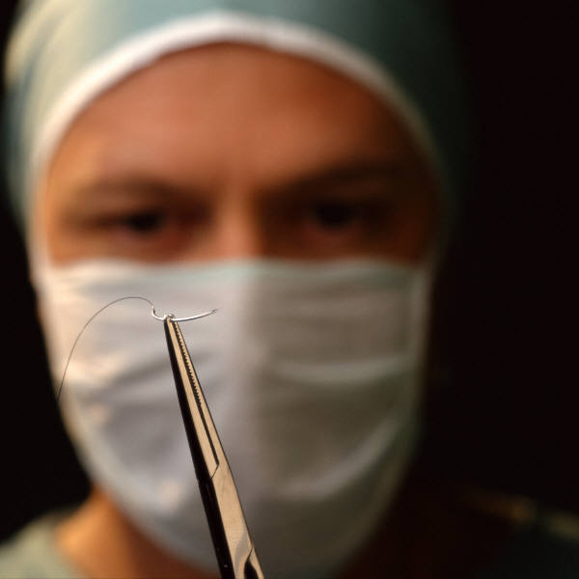
Benefits of simulation
Patients are not exposed to complete novices
Safe environment where mistakes become learning opportunities
Complexity can be altered according to the needs of the student
Self efficacy can be built before contact with real patients

Slide 23

Benefits of simulation
Students can:
repeat the skill as often as necessary to develop confidence
learn at their own pace
experience being ‘on the receiving end’
express their fears and ask ‘difficult’ questions
make mistakes and appreciate the consequences without harm to the patient
Notes:
Students can learn at their own pace, not a pace imposed by patient need or ward routines. Students who lack confidence often hang back and miss lots of opportunities often without busy mentors noticing.
Experiencing what it feels like is powerful learning that is not possible in real practice. (Wheelchair races at night are not allowed now!)
Male student asking about menstruation

Slide 24
Hierarchy of skills learning
10
9
8
7
6
5
4
3
2
1
0
Supervised clinical practice with feedback
Learning in simulation with feedback
Unsupervised clinical practice
Demonstrations & DVDs
Manuals and books
Notes:
I would argue that simulation with feedback (human or video) is better than just ‘being there’ in practice. We have all heard of creative placements for students to ease the pressure of large numbers. I am not saying that you will not learn anything by going to Sainsburys but it would not be clinical skills.
Unsupervised clinical practice can be ‘muddling through’ doing the best you can

Slide 25
Hi fidelity simulation disadvantages
Adrenaline gap
Uncanny valley
Fear / upset
Manpower hours

Slide 26
Practise makes perfect
Practise makes permanent!
Only well supervised practise with
constructive feedback
makes perfect

Slide 27
Simulation as an accepted adjunct to learning?
Bristol Enquiry 2002
NMC
CODP
CoP
HEFCE CeTL’s 2005
2008 CMO report

Slide 28
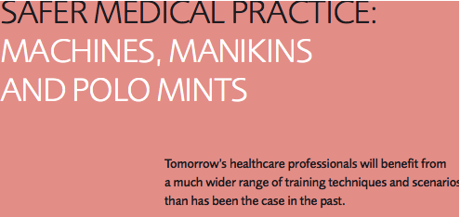
CMO report 2008

Slide 29
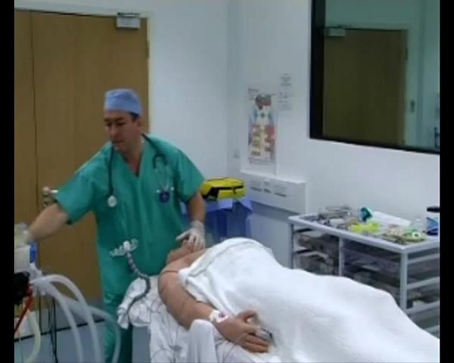
Anaphylaxis simulation

Slide 30
Theory – practice dichotomy
If used correctly simulation will facilitate classical conditioning (2nd nature)
Objective outcome measurement (Anne vs iStan)
Development of communication and psychomotor domains

Slide 31
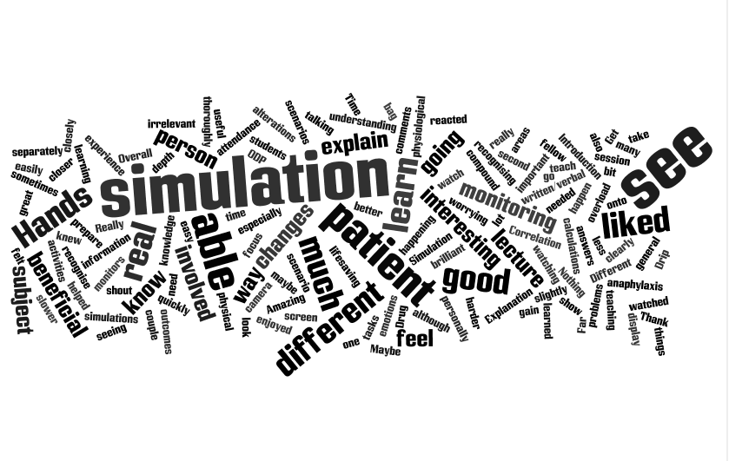

Slide 32
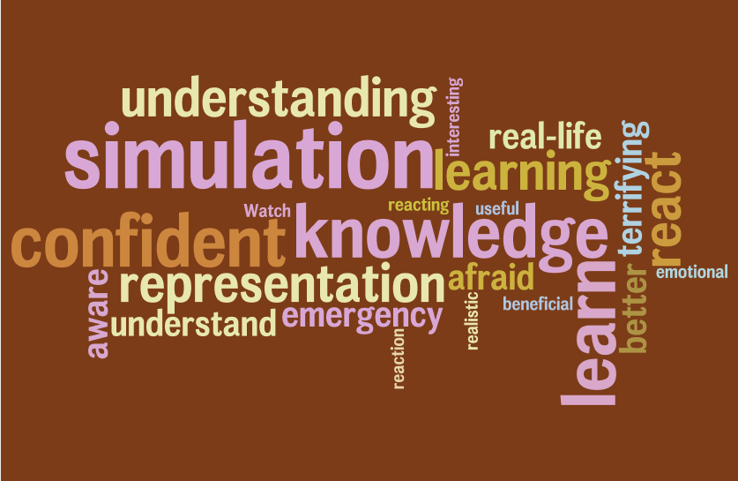

Slide 33
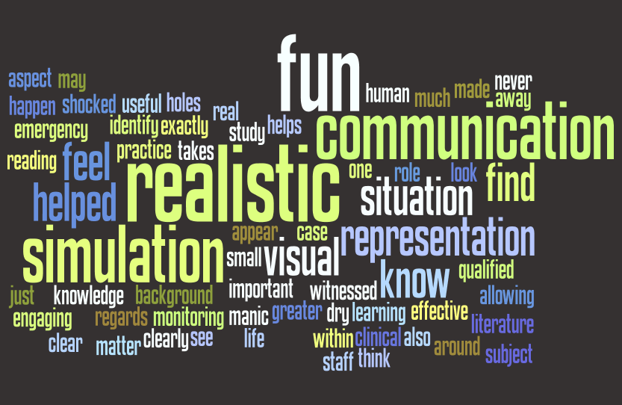

Slide 34
Future??

