Slide 1

Mobile Enabled Disabled Students
MEDS
An Agile Approach To Developing An Accessible IT Solution

Slide 2
Who are we?
Chris Dearnley (Bradford ALPS Site Lead & MEDS Project Lead) c.a.dearnley1@bradford.ac.uk
John Fairhall (Mobile Technology Adviser)
j.r.fairhall@bradford.ac.uk
Jak Radice (Learning Technologist) j.radice@bradford.ac.uk
Stuart Walker (Assistive Technology Advisor) s.a.walker@bradford.ac.uk

Slide 3
MEDS is Part of the ALPS CETL
Assessment and Learning in Practice Settings (ALPS)
Centre for Excellence in Teaching and Learning (CETL)
Competent and confident graduates
A common competency framework with assessments
Assessments delivered online and via mobile devices

Slide 4
What Has MEDS Been About?
Ensure that the ALPS mobile suite is accessible
Limited to the mobile software, ALPS Online E-Portfolio outside of scope
Took into consideration impact of device hardware
Both positives and negatives investigated

Slide 5
Why Is Accessibility Important?
Legal Requirement
Legal requirements due to expand into previously exempt areas / professions
Benefits everyone, not just disabled users

Slide 6
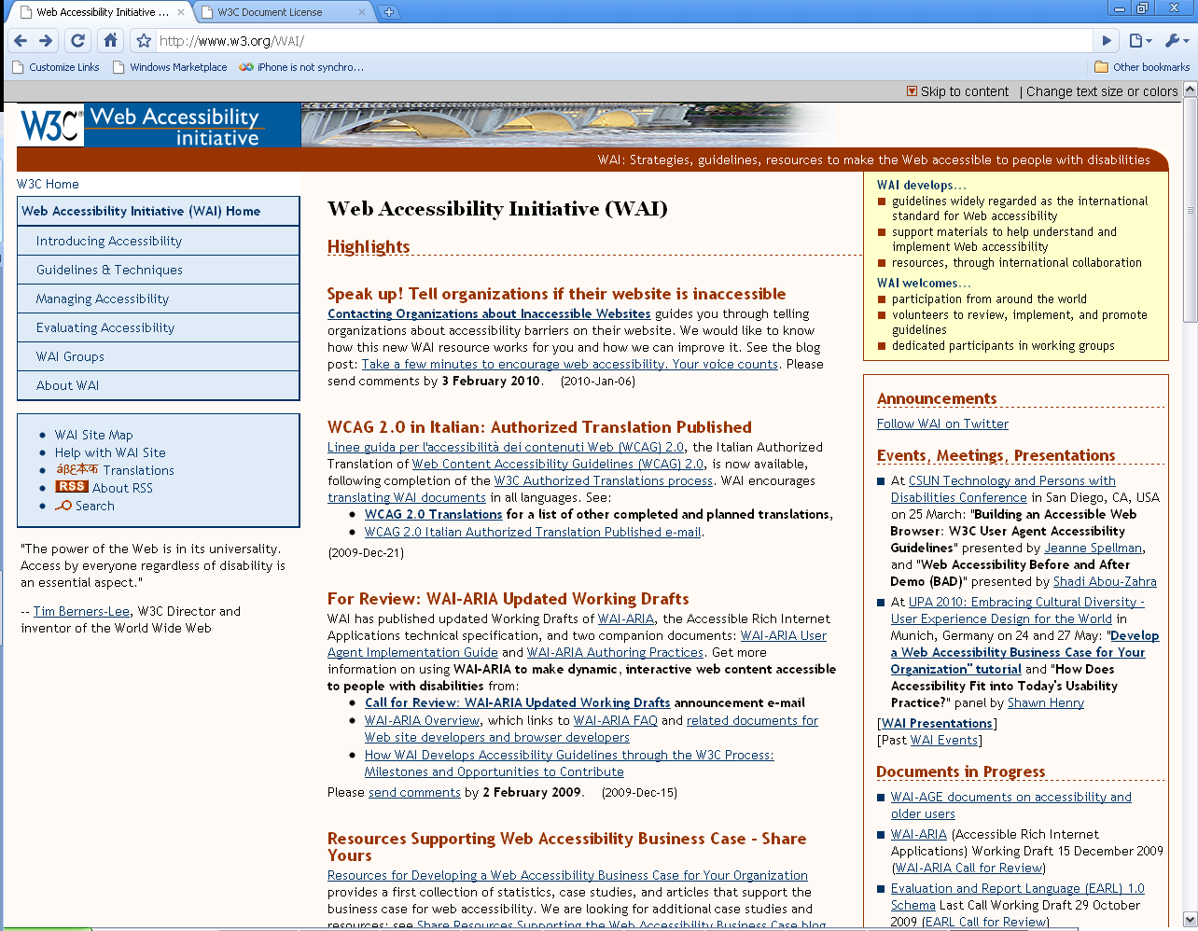
If Accessibility is Already Understood Why Was the Project Needed?
http://www.w3.org/WAI/
Copyright © February 2010 World Wide Web Consortium, (Massachusetts Institute of Technology, European Research Consortium for Informatics and Mathematics, Keio University). All Rights Reserved.http://www.w3.org/Consortium/Legal/2002/copyright-documents-20021231

Slide 7
Why mobile accessibility?
Many organisations still don’t understand their obligations or how to meet them.
Mobile technology is a new field and the hardware brings in new factors for consideration

Slide 8
Why an Agile Approach?
Traditional Methodologies ie: Plan / engineering have been:
  Around for a long time
  Are often Bureaucratic
  Are often Not particularly flexible
Agile approach
  Accepts (to a certain degree) the unpredictability of requirements
  Should allow progress and decisions quicker
  Builds in flexibility.

Slide 9
The Purpose of Phase 1 of MEDS:
Gather requirements for an accessible solution
Inform the development of ALPS client
Ensure accessibility is built in from the start

Slide 10
MEDS Phase 1 Approach
Done in parallel with the development of the ALPS client
Action research methods employed
Focus group held with a group of disabled students on prototype – developers actively participated
6 disabled students take devices to use and keep blog
Closing focus group
Recommendations for development

Slide 11

Stage 2 – Accessibility of ALPS assessment tools
Case Studies: invited 8 participants to use the electronic device with the ALPS assessment tool and to record experiences
  These were then uploaded to an e-portfolio blog
  5 participants agreed to take part
Focus group
Microsoft Accessibility Tool Kit

Slide 12
Capturing the student journey
– Mobile Blogs
  Innovative research methodology
  Ethics
  Shifted locus of control
  Benefits to research mirrored benefits to learning
    i.e. Any time any where
  Potential yet to be maximised

Slide 13
Blogs – the process
  PebblePad e-portfolio Blogs
  Individual support required
  Guide given to students
    when they had used the device for a specific purpose for the first time
    when they had found the device particularly useful
    when they had found specific problems or difficulties with using the device

Slide 14
Microsoft Accessibility Tool Kit
(Benedek and Miner 2002)
  Innovative research methodology....
  Advantages: this technique does not rely on memory, a questionnaire or rating scales and users do not have to generate words themselves
  Participants select 10 “favorite words”
  We adapted the process and were impressed by usability of the method

Slide 15
Accessible | Desirable | Gets in the way | Patronizing | Stressful
Appealing | Easy to use | Hard to use | Personal | Time-consuming
Attractive | Efficient | High quality | Predictable | Time-saving
Busy | Empowering | Inconsistent | Relevant | Too technical
Collaborative | Exciting | Intimidating | Reliable | Trustworthy
Complex | Familiar | Inviting | Rigid | Uncontrollable
Comprehensive | Fast | Motivating | Simplistic | Unconventional
Confusing | Flexible | Not valuable | Slow | Unpredictable
Connected | Fresh | Organized | Sophisticated | Usable
Consistent | Frustrating | Overbearing | Stimulating | Useful
Customizable | Fun | Overwhelming | Straight Forward | Valuable

Slide 16
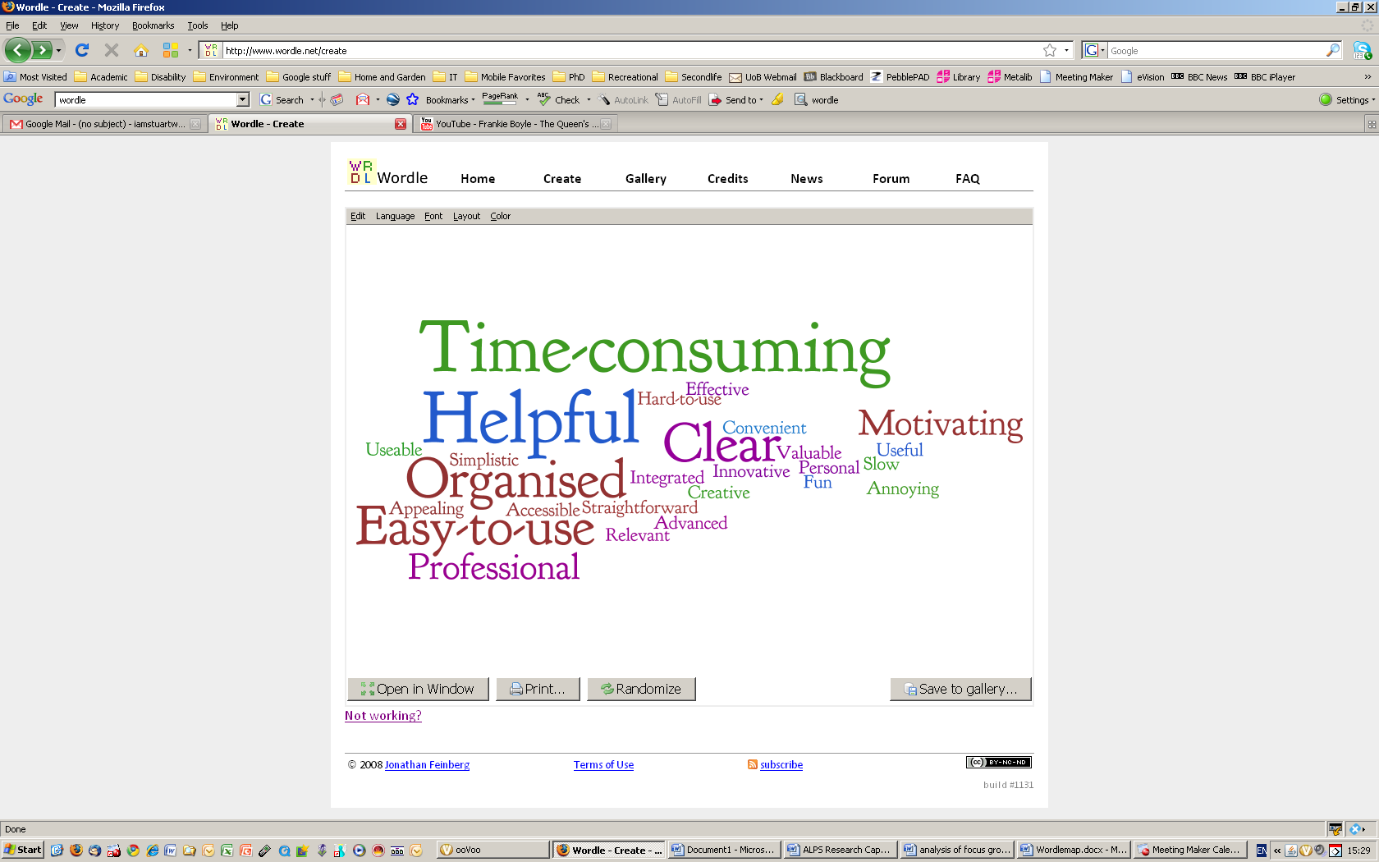
Tool Kit Outcomes – ALPS Assessment Tools

Slide 17
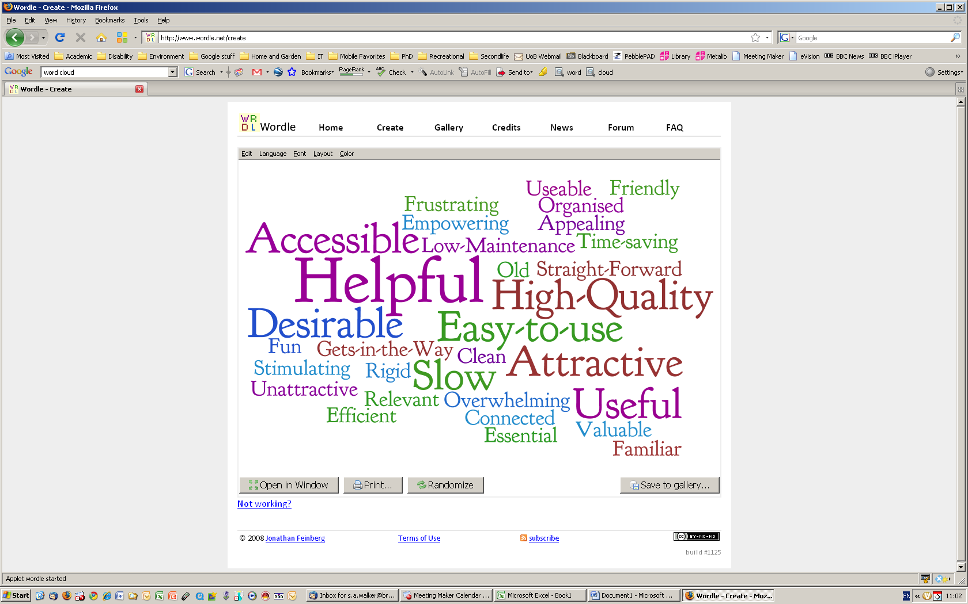
Tool Kit Outcomes:
Mobile Device

Slide 18
Reflections on Approach
Students blogged on the devices:
  Immediate as soon as they had the experience
  Kept students engaged with the technology
  Did require a high level of support and 1 to 1 training
Between first and second focus groups new functionality was put in

Slide 19
The Purpose of Phase 2 of MEDS:
Inform implementation of phase 1 recommendations
Provide a mechanism for testing and refining accessibility

Slide 20
MEDS Phase 2 Approach
Joined by the IT Project Manager and Director of one of the developers
An Agile methodology was employed with rapid versioning
http://martinfowler.com/articles/newMethodology.html

Slide 21
MEDS Phase 2 Approach
5 focus groups held made up of students with disabilities
At each focus group new prototype was demonstrated / tested.
  Previous changes checked
  Next changes agreed

Slide 22
Reflections on Approach
The Agile approached complimented the way the developers worked
  Progress and decisions quicker
  After each iteration there is a clear improvement
It wasn’t always possible to get same participants back

Slide 23
MEDS Phase 2 Outcomes
Demonstration of key stages of ALPS Client

Slide 24
Embedding mobile enabling technology
EMET

Slide 25
The Purpose of EMET:
Does increased desirability of a device improve engagement with mobile learning & teaching?
Study builds on the earlier work of the MEDS.
Explores barriers which may impede embedding of the ALPS mobile Assessment suite.
Current ALPS devices have a functionality that is less than those many students own
Assumption: ‘If it works for disabled students it will work for all’.

Slide 26
EMET – Main question
“Does increased desirability of a device improve engagement with mobile learning & teaching?”

Slide 27
EMET – Approach (1)
2 main issues:
Using range of cutting edge devices – Ask disabled students to use them to access the ALPS assessment suite for a trial period
Explore the recently developed Web based ALPS assessment tool. To explore how useable it is, both as a tool and on a range of devices.

Slide 28
EMET – Approach (2)
5 Focus groups each one testing a type of device & the ALPS web based assessment suite.
  3 participants agreed to take part
  Semi Structured interview (each week)
  Microsoft Accessibility Tool Kit (For each type of device)
  Kelly or repertory Grid (at end of study)

Slide 29
EMET - Technology
HTC Hero (Android operating system)
HTC Touch Pro 2
iPhone / iTouch
Nokia N97
Samsung Q1 Ultra HSDPA
Samsung Q1 EX Ultra Tablet PC
A range of UMPC's as a result of a successful JISC Techdis bid.
DataWind PocketSurfer2 L
DataWind PocketSurfer2R
Viliv s5 Premium 3G GPS Mobile Internet Device

Slide 30
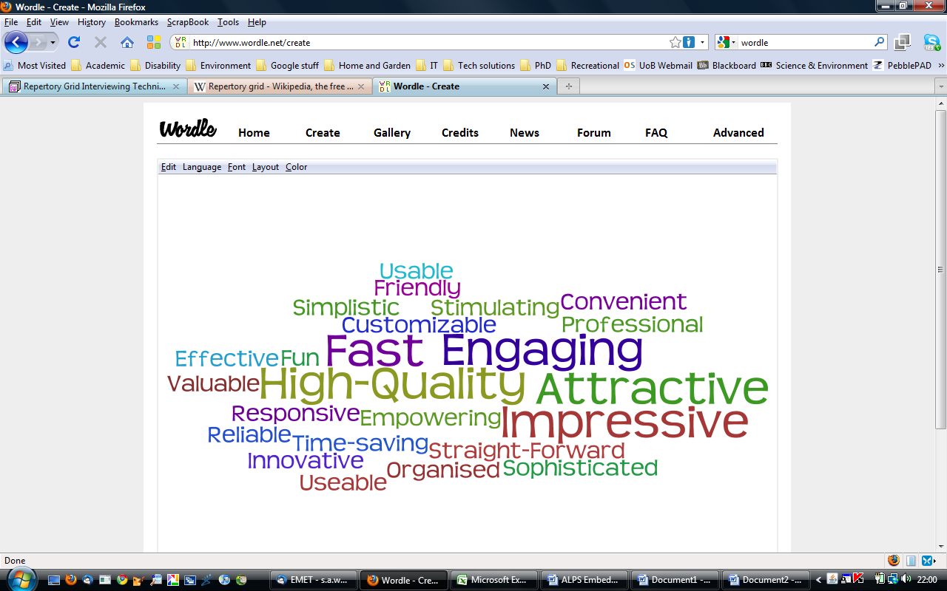
iPhone & iTouch Wordle diagrams

Slide 31
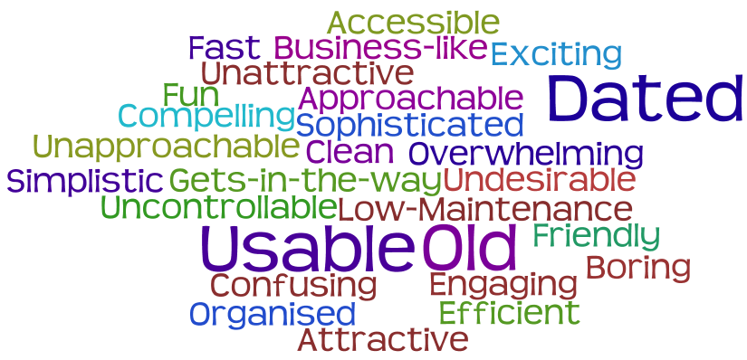
Smart Phones - Wordle diagrams

Slide 32
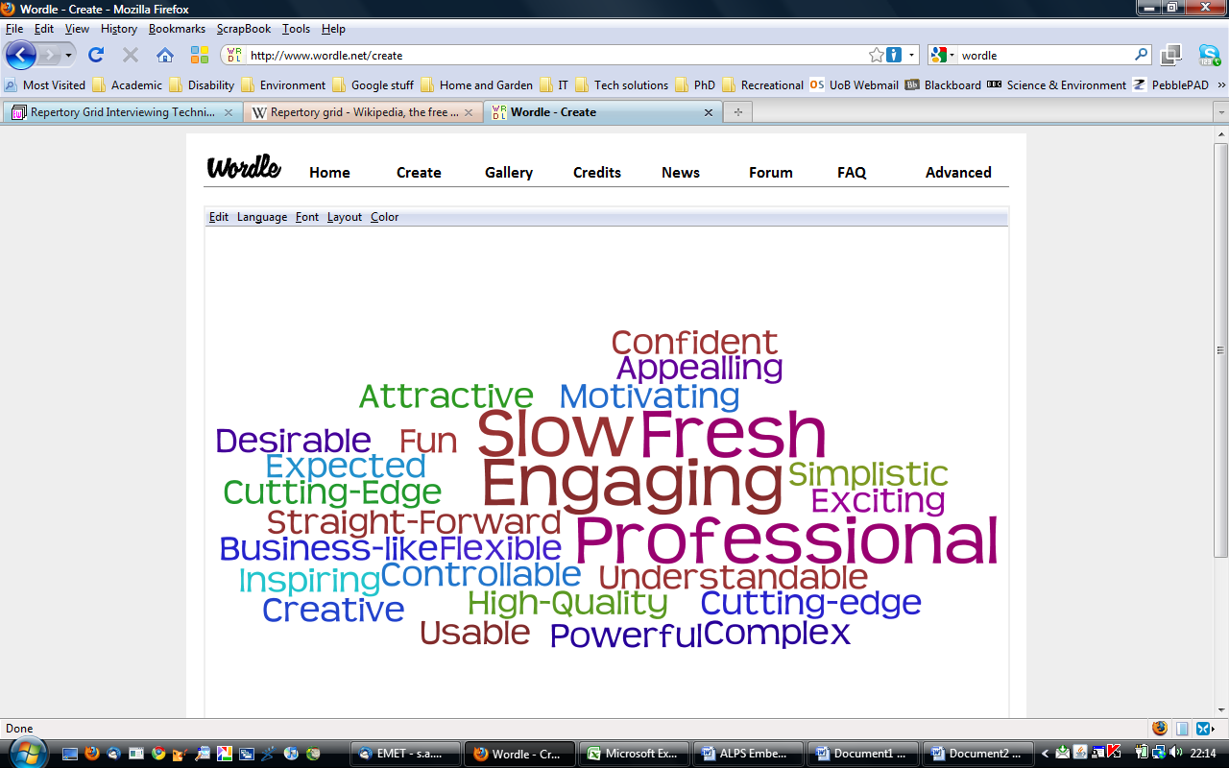
UMPC- Wordle diagrams

Slide 33
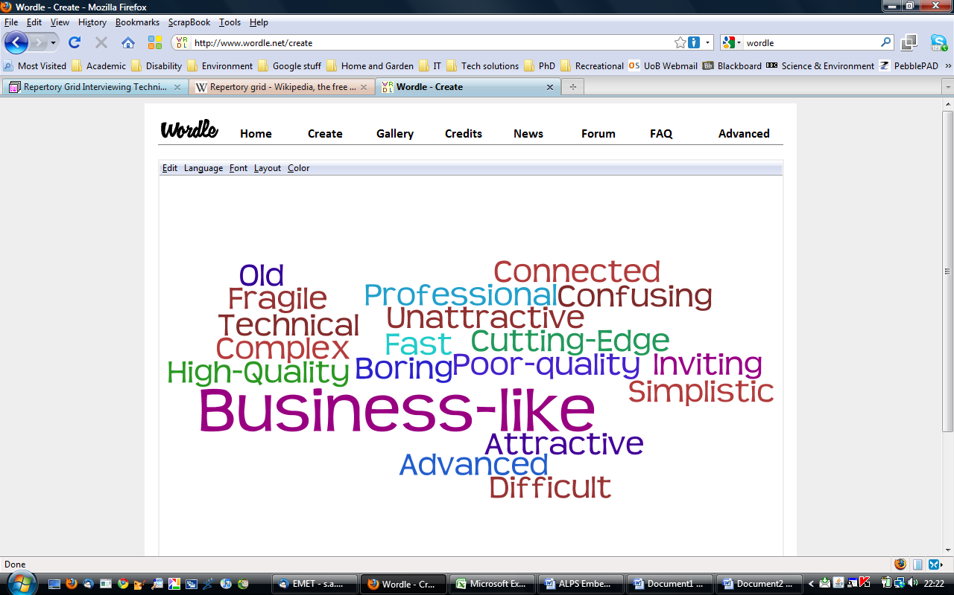
Pocketsufers - Wordle diagrams

Slide 34
EMET Findings / Recommendations
We are currently in the write up part of the project.
However, it does appear that the desirability of a device improves engagement with mobile learning & teaching.
Though this is in the early stages of analysis.

Slide 35
Reflections on the Agile Approach (1)
Agile methods are adaptive rather than predictive. Engineering methods tend to resist change. As they plan the software process great detail, over time.
Agile methods welcome change and build this in from day 1.
These fit well with the ‘Social Model of Disability’ and person centred approaches as they talk to Users of systems.

Slide 36
Reflections on the Agile Approach (2)
Agile methods are people-oriented rather than
process-oriented.
This can be very useful to ensure the client is consulted from the beginning of the project.
Potential Problems:
  It could be argued that Agile methods perceive no process will ever make up the
  skill of a software development team. Thus, the role of a process is to support the
  development team in their work. There is a potential danger that the developers fail to
  listen to the experts ie: users.

Slide 37
Reflections on the Research Methods
  Innovative research methodology
  Advantages: this technique does not rely on memory, a questionnaire or rating scales and users do not have to generate words themselves
  Possible problems
    Potential issues with small scale of study.
    Qualitative Vs Quantitative research.

Slide 38
Building in Accessibility from the Start
Building in accessibility from day one is always preferable to later ‘bolt on’ solutions.
Access for disabled people increases usability and flexibility for all users.
Without forethought and support a useful tool can be rendered ineffective or create barriers for the user.

