Slide 1
Rolling Out and Supporting Mobile Learning – Lessons Learned from ALPS
(A Geeks Tale)

Slide 2
A Geeks Tale?
John Fairhall (Mobile Technology Adviser) j.r.fairhall@bradford.ac.uk
Manager for the ALPS Helpdesk
Involved in roll outs at Bradford Uni
A ‘techy’ not an academic

Slide 3
Lessons Learned from Rolling Out

Slide 4
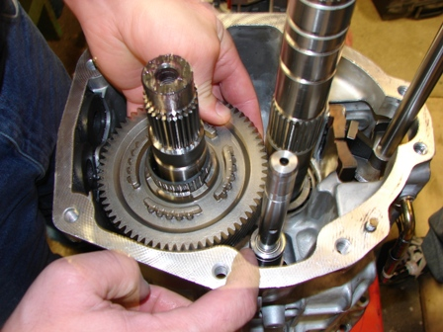
Lessons Learned from Rolling Out
Rule 1.
“Devices should be as ready for use as possible”

Slide 5
No matter how good your documentation...
Asking students to set up, configure or install will:
Terrify less technically confident users
Put the majority off – “Waste of time”
Result in devices not being set up correctly

Slide 6
No matter how good your documentation...
If you try to do a setup “click along”:
People will be at different stages no matter what you do
One person will finish by going through the work sheet
One person will still be configuring email
One person will be trying to configure email, on the time settings screen

Slide 7
Lessons Learned from Rolling Out
Rule 1.
“Devices should be as ready for use as possible”
Sub Section a.
Using an automated ‘imaging’ process helps consistency and speeds things up

Slide 8
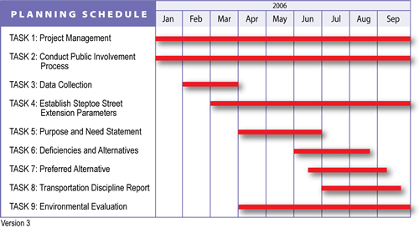
Lessons Learned from Rolling Out
Rule 2.
“Plan in time for technical support at the start of each session”

Slide 9
Even if you obey rule 1...
Technical support will get used:
Heavily at first
Battery problems
Random lock up / crashes
Broken devices, “I slipped in the snow and...”
Make sure you have the right technical staff

Slide 10
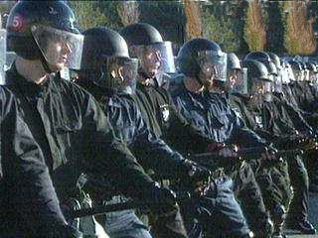
Lessons Learned from Rolling Out
Rule 3.
“Employ proper crowd control”

Slide 11
Well behaved group of students +
Mobiles with technical problems =
Queue jumping / scrum for technical support
Poor techies dealing with multiple problems & users at once
A ‘Red mist’ descending on support staff so problems aren’t always dealt with effectively

Slide 12
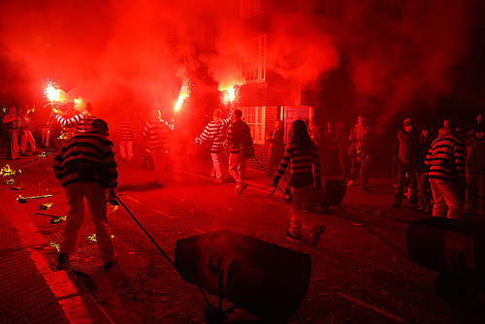
Well behaved students?

Slide 13
Lessons Learned from Rolling Out
Rule 3.
“Employ proper crowd control”
Sub Section a.
Prevent a scrum by ensuring they have something else to do while problems are resolved

Slide 14
Lessons Learned from Rolling Out
Rule 4.
“Be prepared”

Slide 15
Avoid the Red Mist
Have spare devices already set up
Have an SD Card with software / files
Check in advance there is sufficient signal in the room... (too many 2G devices don’t get along)

Slide 16
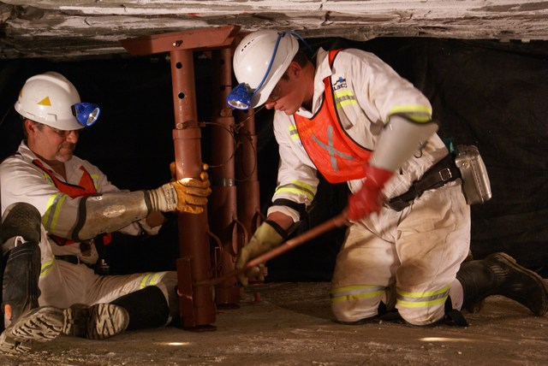
Lessons Learned from Supporting Mobile Learning in Practice

Slide 17
Remote Support is Hard!
There is remote control software but you need a WORKING and FAST (e.g. 3G) internet conenction
Talking the user through over the phone or via email
Trouble shooting documentation
How are broken devices replaced?

Slide 18
Phone and email support
How to publicise to students?
Posters
Label on devices
Students are reluctant to seek help
Be prepared to provide 1 to 1 support

Slide 19
Documentation
Need to be robust – people WILL get things wrong / miss things out
Screenshots
Videos
Students will lose documentation – Web site.

Slide 20
Device replacement
Spares for sessions
Spare at partner sites
Pool at Helpdesk for courier service

