Slide 1
Minding the Gap: addressing student expectations of learning and assessment
Presenters:
Anne-Marie Howes
Bob Collins
Dare Oladokun

Slide 2
Student-led Design of an Ideal ePortfolio System
The ALPS ePortfolio team (comprising 14 students from health and social care courses and 4 members of staff) was set up, as part of the ALPS CETL programme, with three aims:

Slide 3
Aims
Developing a better understanding of how students and staff currently use ePortfolios in health and social care across the 5 Partner HEIs
Suggesting approaches for improving this use.
Championing the use of ePortfolios to reluctant users.

Slide 4
Outline
What’s out there
What current ePortfolios provide
Drawbacks
Designing an Ideal ePortfolio
Things to consider
Pedagogy
Summary

Slide 5
What’s Out There
Some of the HEI systems students are using provide ePortfolio functions e.g.,
Pebble Pad / Pebble PDA
Progress File
ALPS Assessment Suite
EXPO lx
Blackboard.

Slide 6
What Current ePortfolios Provide
All have different interfaces and functions
Capability to blog
Facilities to create and reflect on assets (CV’s, grades, reflection on practice, learning outcomes, Webfolios etc)
Capacity to store files (including drawings, photographs, films)
Communicate/collaborate with tutors and peers
Submit assignments…and more.

Slide 7
Drawbacks
ePortfolios come in many formats and may be incompatible with each other
Often counter-intuitive
Inflexible and limited
Boxy style ePortfolios restrict to searching for satisfactory solutions, rather than optimal solutions
Duplication of function
May have default to publish

Slide 8
Designing an Ideal ePortfolio
Things to consider: Introduction and Support
Timing of introduction – students feel overwhelmed at the start of their courses
Purpose and benefits need to be explained clearly to students
Tutors need to be enthusiastic and present online – especially in the early days
Feedback provided in the ePortfolio needs to be specific, and encouraging
Buddy groups

Slide 9
Human/Computer Interface
Portal access
Linkability
One Login
One Site
One Profile
One Portfolio - One size fits all

Slide 10
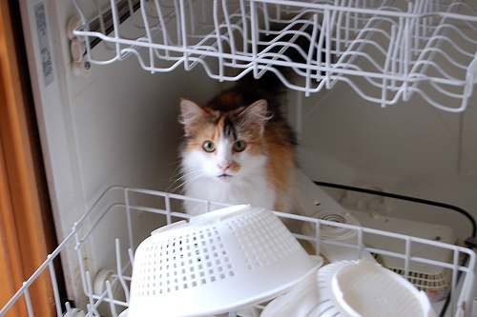

Slide 11
Pedagogy Underpinning ePortfolios
There is a contradiction between the formulaic approach regarding competency based assessment, and the amorphous complexity of personal development, which underpins professional development.
Robotic behaviour and apathy are the outcome of concentration on competencies, because an individual loses – or never develops – the motivation to think and act independently.

Slide 14
How do we develop an ePortfolio that includes competencies, but concentrates/reinforces deep learning, personal identity and self-efficacy?

Slide 15
Deep learning
Customisable
Default private
Free text
Shallow and competency driven
Rigid structure
Default to tutor
Tick boxes

Slide 16
Facilitating Deep Learning
Framework
Templates
Diary/journal
Skill blogs
Mistake blogs
Rant blogs

Slide 17
Example of Integrating Competency and Reflection
http://www.pebbleweb.co.uk/yorksj/login.aspx?referer=http%3a%2f%2fwww.pebbleweb.co.uk%2fyorksj%2fviewasset.aspx%3foid%3d2037%26type%3dwebfolio

Slide 18
Pedagogy
Knowing/deciding when to move on
Recognising threshold learning
Intuitive process/closed systemisation
Flexibility/entrenchment
The difference between confidence and ‘dare I disturb the universe’

Slide 19
Summary of Main Requirements re: an ePortfolio
Intuitive and easy to use
Linkability
Improved learning environment
Access to previous and current learning
Safe and secure document back-up
Support/prompt, appropriate feedback
Privacy/publishing options
Range of sharing functions for groupwork and shared working

Slide 20
References
JISC (2007), e-Portfolios: An Overview of JISC Activities, September 2007. http://www.jisc.ac.uk/publications/documents/eportfoliooverviewv2.aspx, last accessed 17th July 2009.
JISC (2008), Effective Practice with e-Portfolios – Supporting 21st Century Learning. http://www.jisc.ac.uk/media/documents/publications/effectivepracticeeportfolios.pdf, last accessed 17th July 2009.
Murray C (2006), Is Anybody Out There? Developing the Skills for Lifelong Learning: Towards a Model of Engagement in the E-Portfolio Process', E-portfolio 2006 Conference, Oxford

Slide 21
Any questions?

Slide 22
ALPS ePortfolio Project Team
Robert Collins, Alice Cotton, Alan Coulthurst, Niall Dew, Jan Frost, Francesca Greer, Pat Harkin, Anne-Marie Howes, Gisselle Hull, Shafiq Hussain, Dare Oladokun, Sarah Platts, Rachel Stevenson, Clare Thorpe, Naomi Townend, Tamsin Treasure-Jones, Kate Trigwell & Rachel Wild. The project involves the Universities of Bradford, Huddersfield, Leeds, LeedsMET and York St John.
Please contact T.Treasure-Jones@leeds.ac.uk for further information about the project.

