Slide 1
Clinical Skills Training
Sustained benefits for foundation doctors
Dr Georgia Tunnicliffe

Slide 2
Overview
Why is skills training necessary?
The Study: Methods
The Study: Results
Implications
Questions and discussion

Slide 3
Why is skills training necessary?

Slide 4
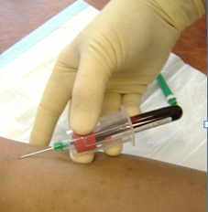

Slide 5
“On the job” Experience
The literature

Slide 6
Boots, 2009
314 Newly qualified doctors
?
Competence and experience in procedural skills

Slide 7
Boots, 2009
314 Newly qualified doctors
!
Highly variable in the first year

Slide 8
Lambert, 2006
2003 Study of UK doctors on completion 1st Post Graduate year

Slide 9
Lambert, 2006
2003 Study of UK doctors on completion 1st Post Graduate year
47.9%
reported that they had gained a “wide experience” of clinical procedures

Slide 10
Stolarek, 2007
New Zealand study
Opportunities to practice procedural skills
Less often than weekly in first year medical graduates

Slide 11
Challenges in gaining competence

Slide 12
Challenges: Ethical concerns

Slide 13
Challenges: Working hours

Slide 14
The Foundation Programme
2005 to date

Slide 15
Built around Curriculum for first 2 postgraduate years
Broad range of clinical exposures
Meet key educational requirements
Currently does not incorporate specific clinical skills training

Slide 16
The Study: Methods

Slide 17
Participants
22 Foundation Year One doctors (F1)
All had skills course within 30 days
47 Foundation Year Two doctors (F2):
Group A n = 23 (skills course at day 0)
Group B n = 14 (skills course at day 60)

Slide 18
Intervention
Assessment of knowledge and perceived competence
Clinical Skills workshops undertaken
Assessment of knowledge and perceived competence

Slide 19
Skills taught
Skill | F1 Doctors | F2 doctors
1 | Peripheral Cannulation | Lumbar Puncture
2 | Venepuncture including blood cultures | Non Invasive Ventilation
3 | Peak flow measurement | Chest drain insertion
4 | Arterial blood gas sampling | Arterial blood Gas sampling and arterial line insertion
5 | Central line insertion | Central line insertion
6 | Urinary Catheterisation | Airway management.
7 | Naso-gastric tube insertion

Slide 20
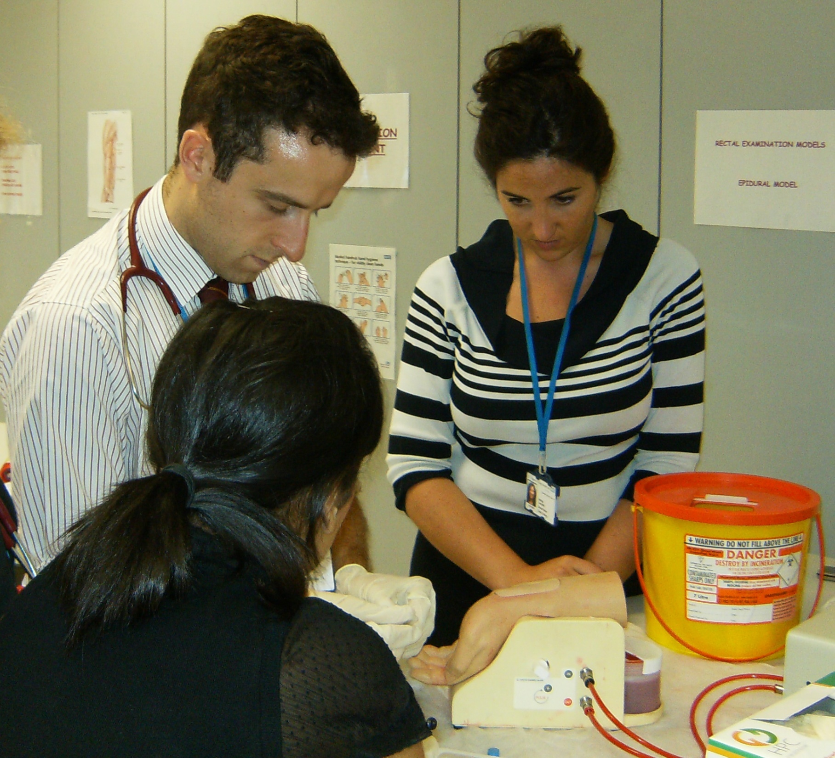

Slide 21
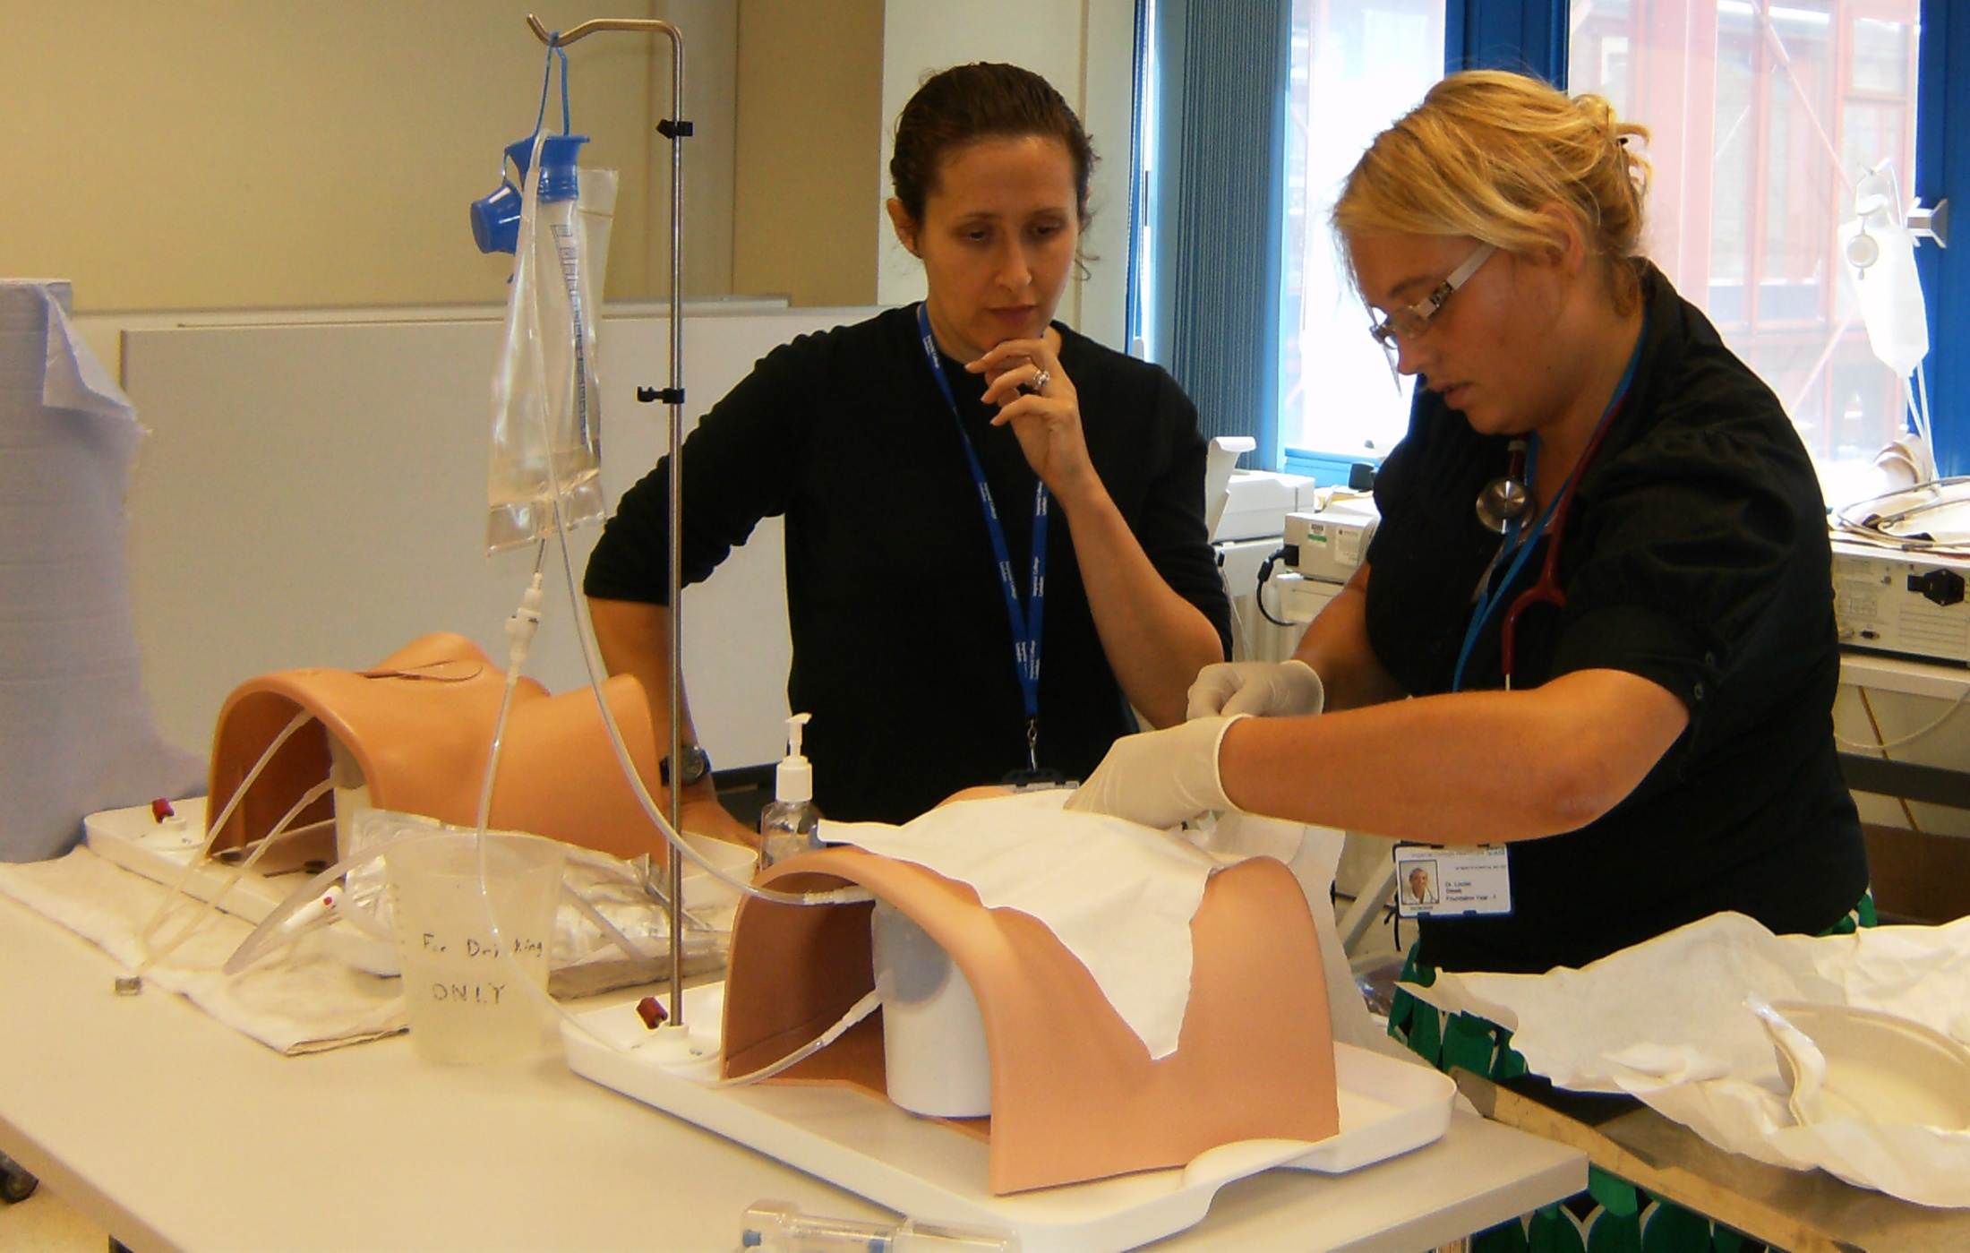

Slide 22
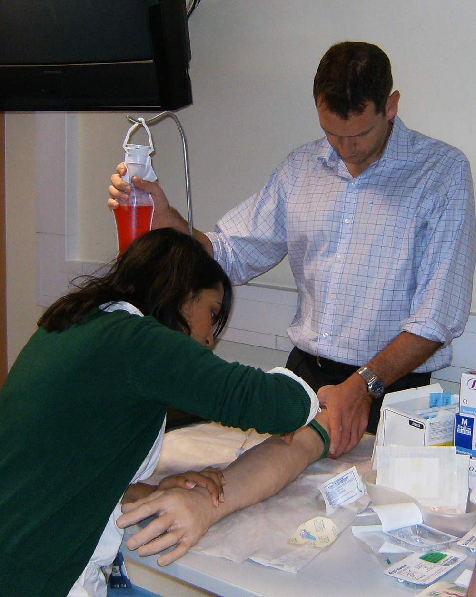

Slide 23
Testing

Slide 24
22 Foundation Year One doctors (F1)
Test 1
Test 1
Clinical skills training
Clinical skills training
Test 2
Test 2
Experiential Learning
Test 3
47 Foundation Year Two doctors (F2)
Group A (23)
Test 1
Clinical skills training
Test 2
Experiential Learning
Test 3
Group B (14)
Experiential Learning
Test 3
Clinical
Skills
training

Slide 25
MCQ
Knowledge based questions
Indications for/ complications of the procedure
12 stem questions
Three to five Tue/False answers

Slide 26
Perceived Competence
You feel that you are definitely not competent
You have undertaken this procedure but would not feel competent even with supervision
You feel competent under supervision
You feel competent without supervision
You feel able to teach this skill to medical colleagues

Slide 27
Analysis
MCQ data
Analysed using unpaired T tests
Results reported as a mean score
Perceived competence data
Analysed using the Mann Whitney U test
Results are reported as a median score

Slide 28
The Study: Results

Slide 29
MCQ

Slide 30
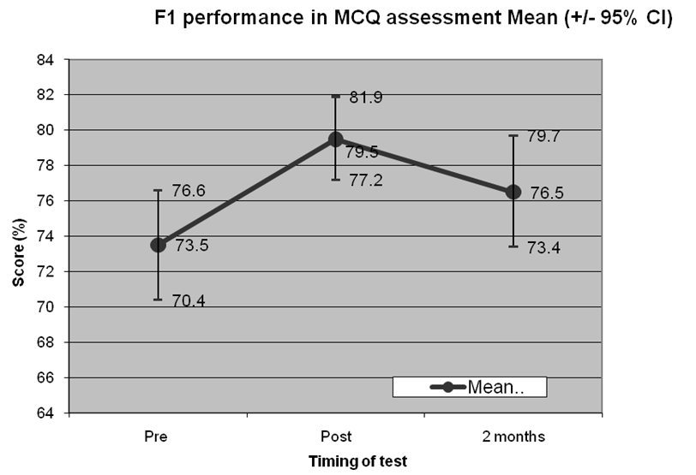

Slide 31
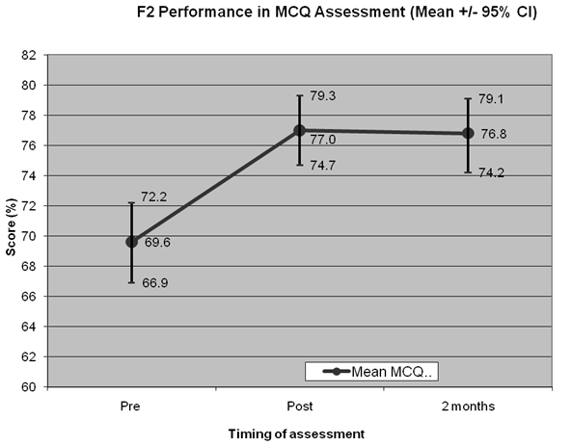

Slide 32
Comparison with experiential group (F2)

Slide 33
F2 MCQ scores
 | Group A Pre-course | Group A Post-course | Group A 57 Days Follow Up | Group B Pre-course
N | 23 | 23 | 9 | 11
Mean | 69.57 | 76.98 | 76.68 | 68.92
SD | 6.12 | 5.26 | 3.16 | 8.16

Slide 34
Perceived competence

Slide 35
Perceived Competence
 | n | BiPAP set up | Lumbar Puncture | Chest Drain | Arterial Line | Arterial blood gas
Pre-Course | 23 | 1 (1-3) | 3(1-4) | 1(1-3) | 1(1-4) | 5(4-5)
Post-Course | 23 | 3 (1-5) | 3(1-4) | 3(1-4) | 3(1-5) | 5(4-5)
2 month analysis | 9 | 3 (2-4) | 4(3-4) | 3(1-4) | 3(1-4) | 5(5-5)
Experiential group | 14 | 1 (1-3) | 3(1-5) | 1(1-4) | 1.5(1-4) | 5(5-5)

Slide 36
Discussion
Early skills training offers sustained benefits in knowledge and perceived competence
Over and above experiential learning alone

Slide 37
Limitations
Only F2 doctors achieved statistical significance
Small sample sizes
Several participants lost to follow up
Different facilitators taught on different days
Recall bias of repeating the same test
Perceived competence does not equal actual competence

Slide 38
Implications

Slide 39
Implications
Clinical skills training sessions should form part of standard training for foundation doctors
Should take place early in their posts
May have wider implications for other health care professionals

Slide 40
Questions and discussion?

