Slide 1
Embedding ALPS in Medicine
Gareth Frith
Technology Enhanced Learning Manager
School of Medicine

Slide 2
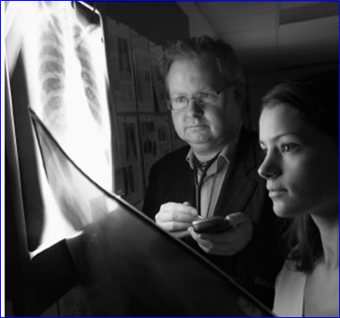
Supporting MBChB
Why are we doing this?
Helping a student learn how to be a doctor
Students need support in Practice
Supporting a student’s learning
Giving student access to information
Mapping skills and competencies against Tomorrows Doctor 2009
Reflection and evidence taking is important
Support for e-portfolio – PDP and Lifelong learning

Slide 3
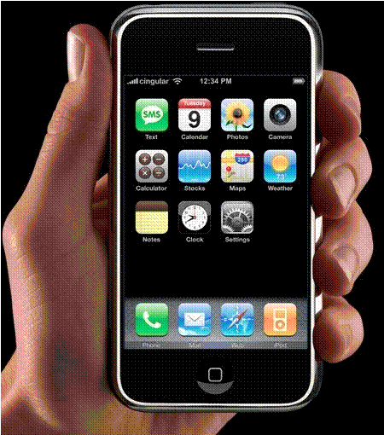
Challenges
User acceptance of the device and the assessment process.
ALPS Devices need replacing – HEFCE
Device Technology has moved on.
iPhone,
Windows Mobile 6.5,
Android.
Availability of content for Medicine
Upgrading Security products
Funding

Slide 4
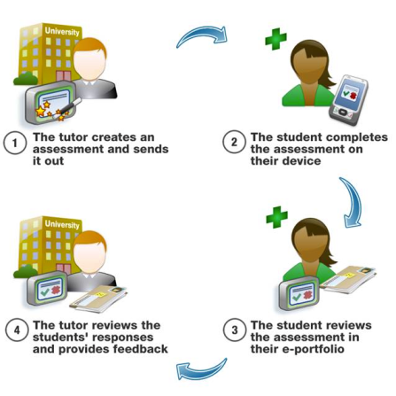
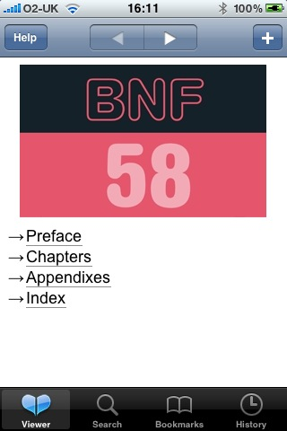
What are we doing
Adopting Alps Assessment cycle
Adopting methods from Skill and Competency mapping
Tomorrows Doctor 2009
iPhone technology
User interface
Published content from Medhand, WaveMedical and BMJ
BNF Formulary
Oxford Handbooks
BMJ onExamination
Interface to Medicine e-portfolio

Slide 5
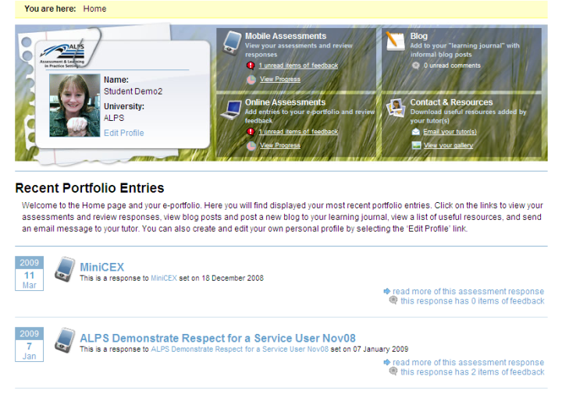
How has ALPS helped?
Significant contribution to our ideas and direction
Done the ground work on how to represent skills frameworks
Pitfalls and advantages of mobile deployment
Importance of user acceptance
Importance of tutor acceptance
Positioned the role of the e-portfolio
Given us the confidence to adopt innovative ideas and techniques
Evidence to influence the University wide agenda

Slide 6
Questions

