Slide 1

The value of e-assessment in interprofessional education and large student numbers
Melissa Owens*
John Dermo*
Fiona MacVane Phipps
*Presenters

Slide 2
The Challenge
Large cohort of approximately 350 students
  Recognition of value of student-centred assessment
  Linking the process of interprofessional learning to the outcome through assessment (WHO 2009)
Desire to test student engagement as well as knowledge
Notes:
This was a year one, semester one module which was delivered to students from across 5 different pre-registration programmes. The challenge of any interprofessional education initiative is to ensure that the assessment is related to the process of engagement and that engagement involves small group work and androgogical ways of learning (WHO 2009). Assessment therefore must be based on the learning process

Slide 3
The Module
10 credit year one, level one module
One week of face2face contact involving lectures, small group work and on-line activities using problem based learning (PBL) and problem based e-learning (PBeL)
8 weeks of on-line activities in small discussion groups using PBeL
Final assessment by MCQ and Peer Assessment, both delivered electronically
Notes:
The challenge of delivering a module across programmes is mostly administrative. Students are likely to be in different places at different times and the value of using e-learning is that it enables students to engage ayscyncronously and thus reduces the logistical challenges of bringing together large numbers of students. Additionally, using PBL & PBeL means that students are required to undertake their own investigations and the benefits of this approach is that students should be able to reflect on and apply their knowledge more readily to their own practice.

Slide 4
Attributes of Electronic Multiple Choice Questionnaire (eMCQ)
It is objective, rather than subjective
Can be used to test analytical skills
It is an efficient and valid method of assessing large numbers of students in a short space of time
Machine-graded, thus expedite results
Notes:
Whilst there are criticisms towards the use of MCQs, there are also many benefits. It can for example, test a knowledge base and provides a good balance to assessments more lenient to subjectivity.
MCQs have been criticized for only being able to test knowledge recall but careful compilation of the questions should allow higher levels of understanding, on Blooms taxonomy of learning (1956) to be assessed
Blooms taxonomy of learning can be used as a measure to relate the level of the questions to the degree of difficulty required. A this was a level one module, most questions related to knowledge recall rather than analysis or synthesis of information.
The pre-assessment examination process will be greater than that of conventional assessments using assignment submission or paper-based exams. However, this is readily balanced by the speed by which results are available with limited human input.

Slide 5
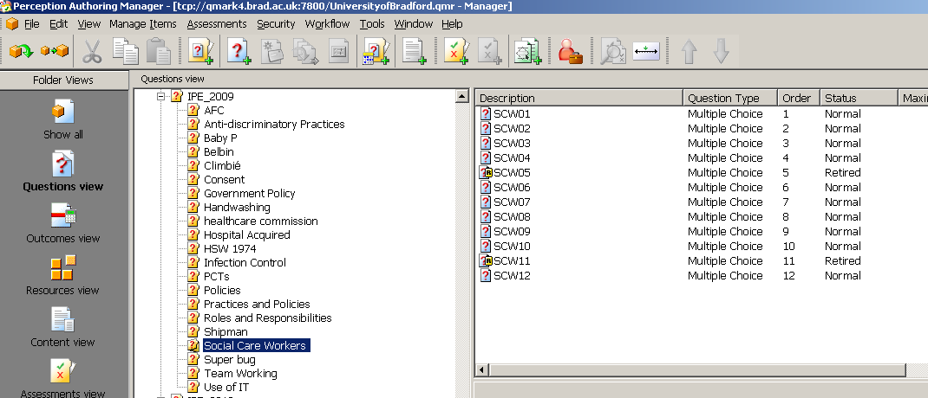
MCQ Assessment with QMP
Item bank with 21 topics, reflecting the content
of the module and the learning outcomes

Slide 6
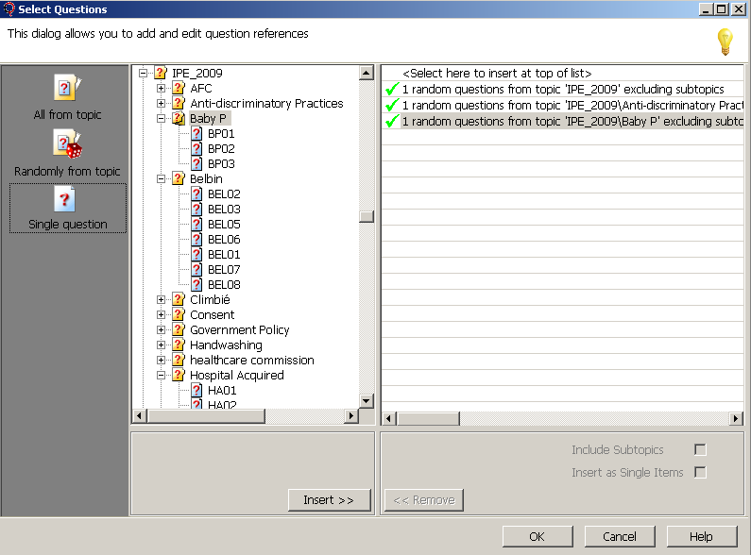

Using Questionmark Perception allowed for randomisation of item selection from different topics in item bank (35 questions from 21 topics)

Slide 7
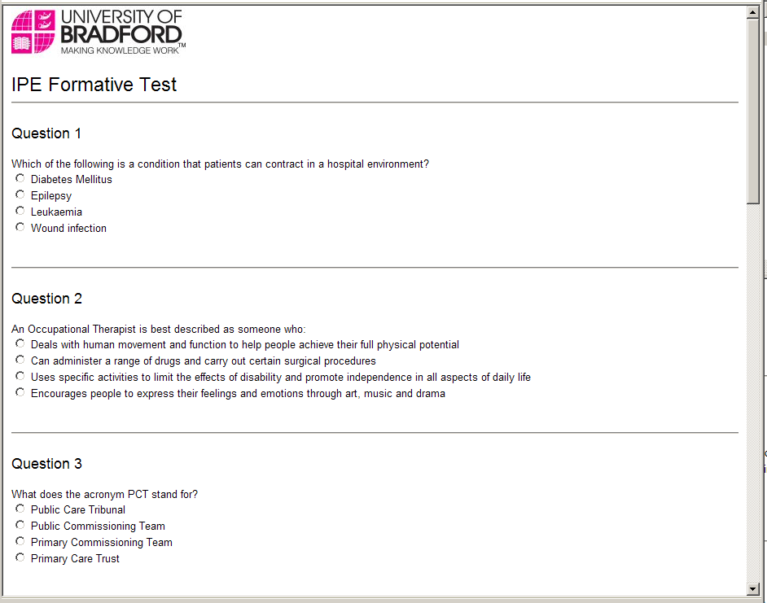
In accordance with university regulations for e-assessment, students receive a mock practice test via the VLE before the real test:
same format and layout, just shorter

Slide 8
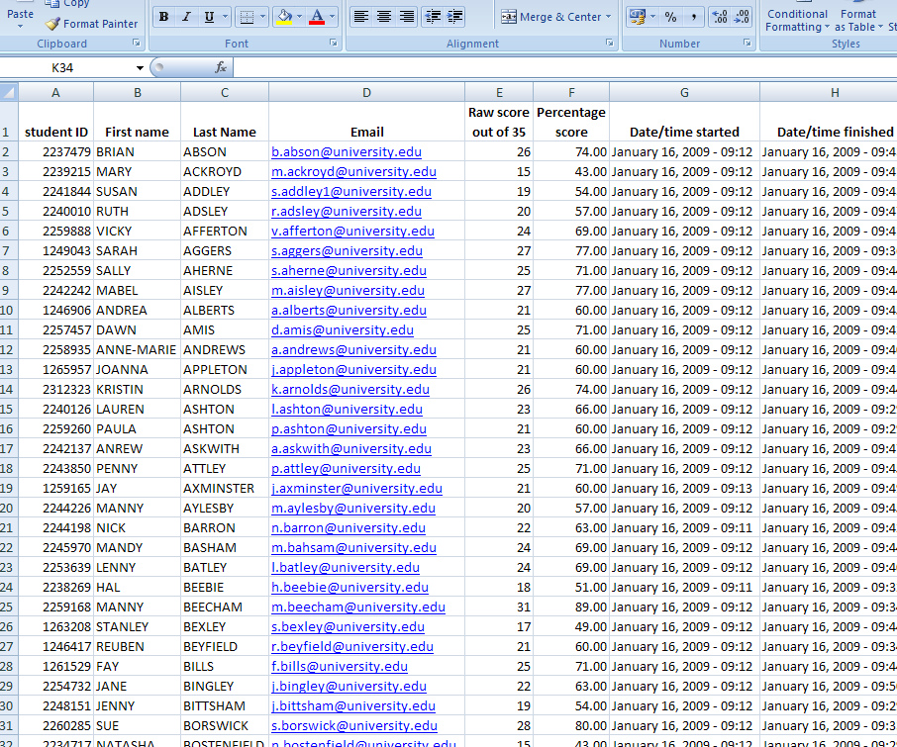
MCQ Assessment report
Questions automatically marked, then report generated in the form of a spreadsheet
Gives raw score and percentage, also picks up student name, email and ID from login
Could give more detail
e.g time taken,
Computer ID

Slide 9
Delivery of Exam
3 sittings of one hour each for both components
Computer suites used
Allow for 10% computer failure

Slide 10
Attributes of Electronic Peer Assessment
It is readily deliverable and the results can be speedily collated
Enables students to better judge the quality of their work and that of others
A skill that students develop over time
What is being valued?
  Tutor or student perceptions?
Notes:
What is valued? If basing the module purely on an androgigal model, then it could be argued that the marks students award each other should not be altered. Conversely, as the students were novitiates, it could equally be argued that they need time and practice in order to be to assess each other and learn confidence in order to penalize their peers. It is known that qualified staff struggle to fail students in practice and therefore it would be unfair to expect first year students to be able to do so.

Slide 11
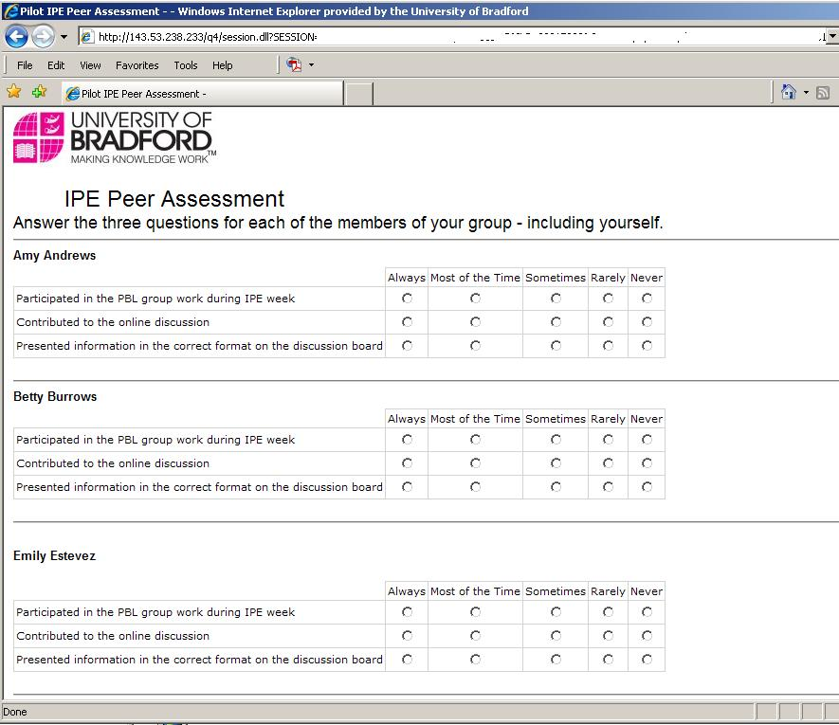
Answer 3 questions per group member, then click submit

Slide 12
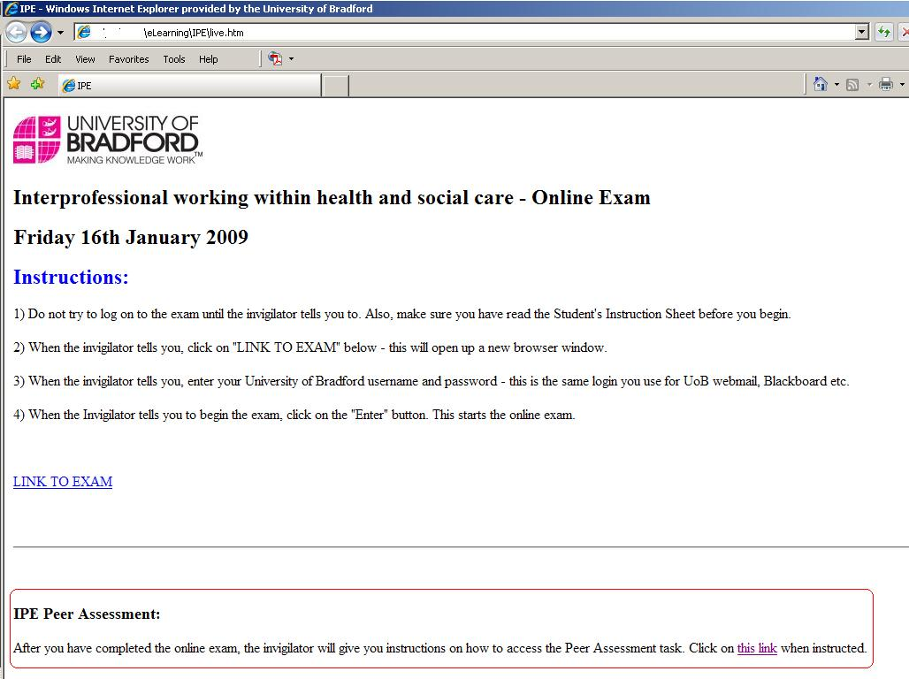
Links from the webpage where the online exam had been delivered

Slide 13
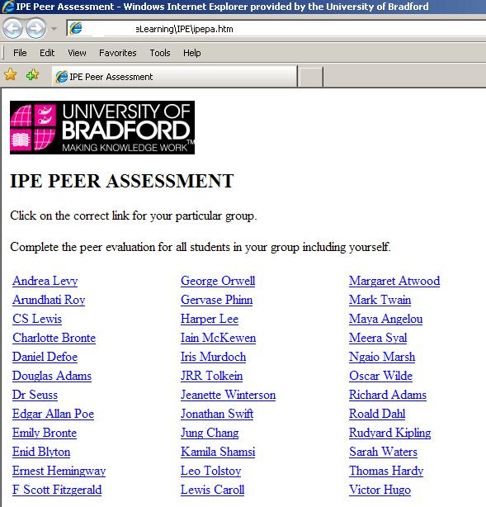
Choose the correct group from the list

Slide 14
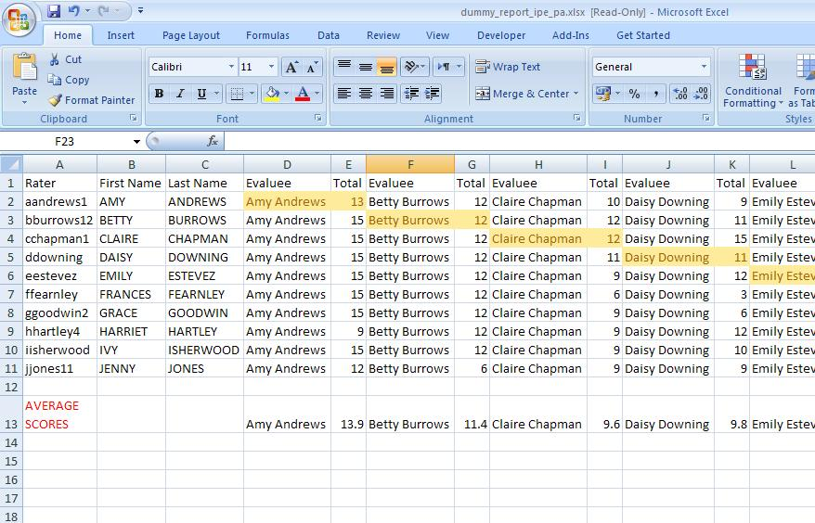
Analysis of Peer Assessment
QMP generates a report in the form of a spreadsheet

Slide 15
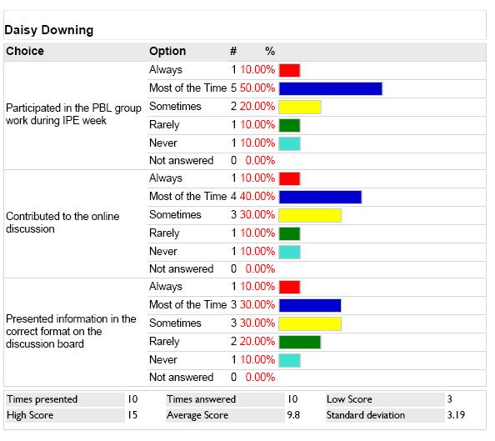
Or potentially more detailed reports per student – if there was time to process so much detail….

Slide 16
Results on MCQ and
Peer Assessment Tasks

Slide 17
Rank correlation between the scores of the 333 students who were assessed in both tests indicates a small but significant correlation with (rho= .25), significant at the .01 level.
The Spearman test was used in preference to the Pearson test, because of the skewedness of the PA results

Slide 18
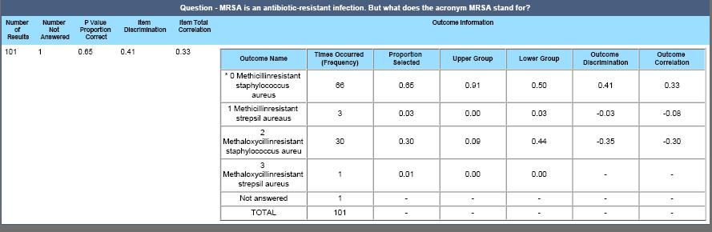
Item Analysis
Ensure the tests are as reliable and fair as possible
QMP reporting tools provide a wealth of data which
enables instructors to analyse the performance of each
item, including how each distracter performs
This enables improvements to the bank to be made from
one assessment period to the next

Slide 19
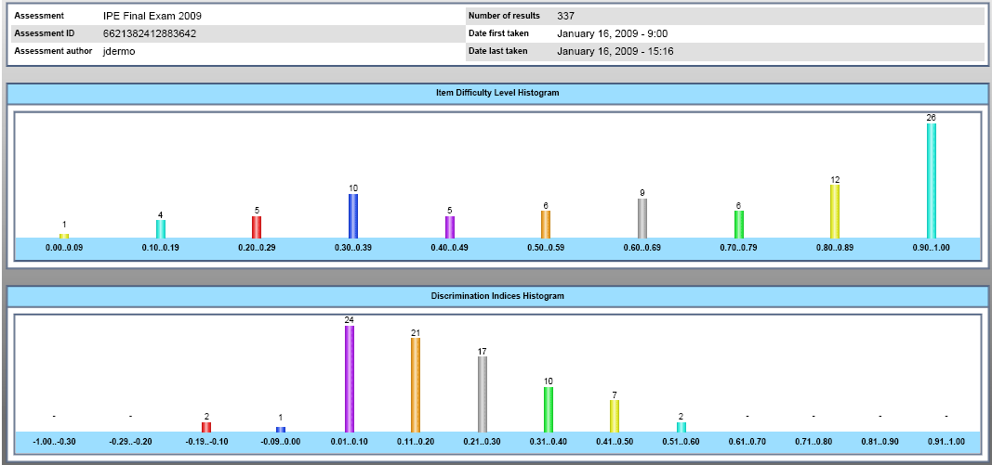
Assessment Analysis
Classical Item analysis of the 84 items: shows a fair distribution of levels of difficulty of items, although the largest group is in the top band (0.9 and above).
Items selected at random (35 out of 84), so standard tests of reliability (e.g. Cronbach’s Alpha or split-half) not suitable.
Latent trait analysis (eg Rasch Analysis) not appropriate because insufficient number of attempts for some questions.

Slide 20
Conclusions
Combining methods of assessment advantages a greater number of students
Combining methods of assessment enables multidimensional testing to occur
Preparation is time consuming. Results can be expedited speedily
Use of QMP enables statistical analysis of MCQs to occur and enhance validity over time
Use of QMP enabled large numbers of students to peer assess
There was a small but significant correlation between level of achievement in MCQ and in Peer Assessment

