Slide 1

“It Ain’t What You Do…………..”
Christopher Murray
School of Medicine
FACULTY OF MEDICINE AND HEALTHCARE
Notes:
This morning we will briefly tell you about an e-portfolio project designed to assist students in making decisions about and applying to university –in particular to medicine and healthcare courses.

Slide 2
Outcomes
Examine critically the types of learning which e-portfolios can support
Define e-portfolio learning
Identify factors which impact on e-portfolio usage
Investigate how to implement e-portfolios into the curriculum

Slide 3
Outline of Session
What we have done
Exercise ‘I Heard a Rumour’
What we’ve found out/Latest research
Curriculum exercise
Round up

Slide 4
What We’ve Done
Enhancing Learning Progression Project
FE to HE
Nurses
Foundation Year Doctors
MBChB Progress File
F:EED Project
Notes:
Since 2005 we have been involved in the development, support and evaluation of a number of e-portfolio projects. These include the ELP proejcy which worked with Yr12 students, 1st year nursing students and fy docotrs, the MBChB Progress File which spans all 5 years of the medical degree at Leeds and the F:EED project which is currently researching tutors usage of e-portfolios with students. All of the points made today will be based on vidence collated from these prohects and will hopefully provide a forum for thinking, and sharing of ideas.

Slide 5
The Move to ‘e’
Broaden the types of evidence
Repurposing the evidence
Encourage non-linear thinking
Multiple audiences
Easier to find evidence
Development of digital skills
Evidence that students spend more time with ‘e’ format than paper-based .

Slide 6
What Was the Purpose?
College/Year 12-Career making decisions and supporting their applications to courses in healthcare and medicine
Foundation Year Doctors-Record of work-based assessments to move onto FY2
Nurses/Medical Students-Supporting Personal Development Planning

Slide 7
But………..
Self Audit
Goal Setting
Constructivist Learning
Smaller leading to a broader picture

Slide 8
What they collected
Records of formative/summative assessments?
Structured reflections on experiences, progress, feedback, learning?
Learner journals/diaries?
Feedback from clinician supervisors, course tutors, personal tutors, careers advisers, peers?
Witness testimonies
Evidence that -a type- of learning has occurred over a period of time!

Slide 9
I Heard a Rumour
Can and Can’t!
From the statements provided sort out the claims in to:
What you believe the use of an e-portfolio can do
What you believe the use of an e-portfolio can’t do

Slide 10
Dependent Factors!!

Slide 11
Typology
Non-User
Reader
Tentative
Selective
Continuous

Slide 12
Factors
Technology
Relevance/Curriculum
Focus
Assessment
Feedback

Slide 13
Technology
Tutor not student
Links with other organisational systems?
What functions do you need the technology to perform?
Students want control
Private entries and the ability to choose and re-edit what they present
Linking to evidence from blog entries or exercises within the portfolio as evidence
Space to make a mess!
Mobile access

Slide 14
Curriculum
Focus?
Time period? Continuous or broken down?
Identified ‘moments’ in the curriculum
Highlighting to students

Slide 15
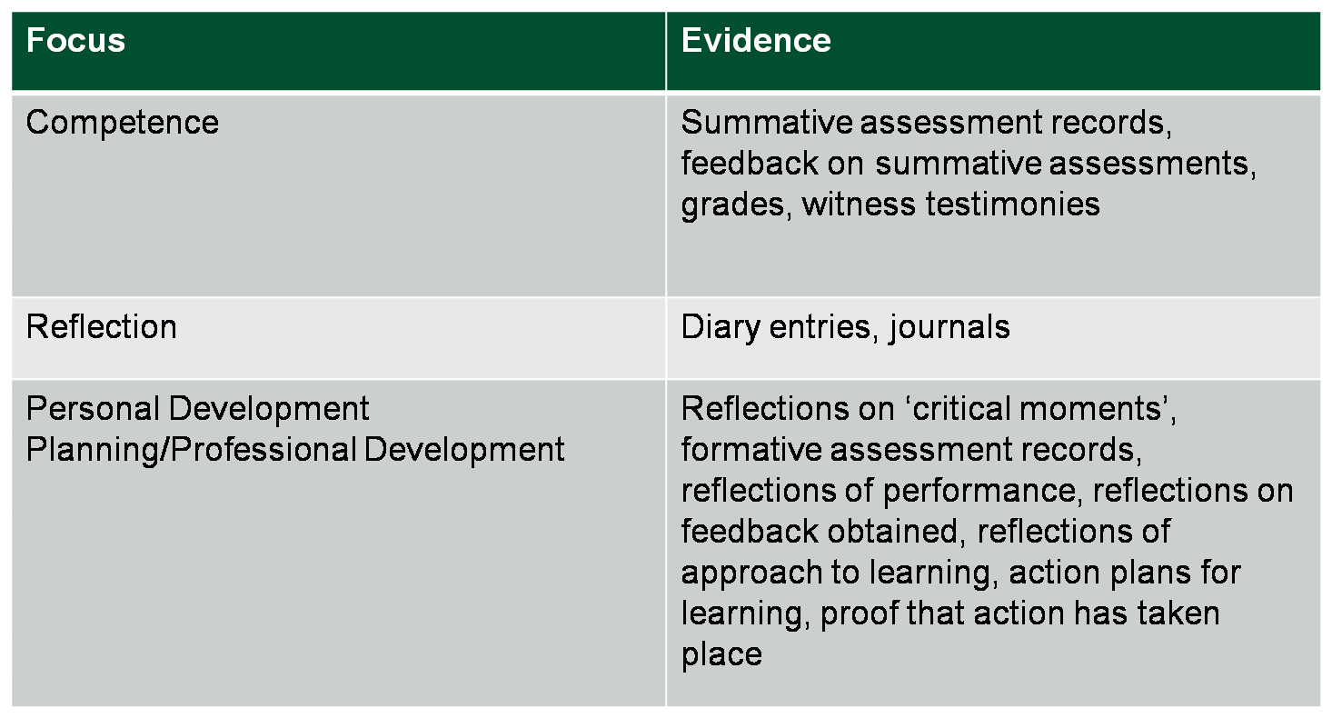
Focus

Slide 16
Assessment
Not content but the presentation of evidence
Formative or Summative
Students more likely to engage if there is a form of summative assessment involved
How do you assess? What evidence matters?

Slide 17
Feedback
Issue of product vs. process
Feedback throughout collection phase
Focus of this feedback
Who should give this feedback?
Relationship
Training

Slide 18
The Learning
Initially scaffolding the process
Making sense of the mess!
Deciding and re-organising elements from within their space to present to an audience
Recognising opportunities to record
Focus of Learning

Slide 19
Really Saying Something
Planning exercise
1 What is the focus of portfolio learning in your context
2 How you would relay this message to students
3 What are the points/activities in the curriculum which are appropriate to encourage evidence collection
4 Will you assess and how will you assess?
5 Where are the presentation points for students?
6 What will feedback be provided on and when?
7 Have you identified the functions you want from the technology?
8 Training-technological or/and pedagogical?
9 Cost?

Slide 20
Hard Times!
In these hard times we need more high quality evidence/research to back up the anecdotal claims made about e-portfolios and the learning they support. We need proof that they have an educational impact on learners!.

